Slide 1
Managing Health & Safety within the Waste Industry
Keith Jackson
Binn Group

Slide 2
Aims
Gaining an insight into preconceptions of Waste Industry Businesses
The challenges faced when dealing with a workforce of mixed ability
Fire
Human-Vehicle Interfaces

Slide 3
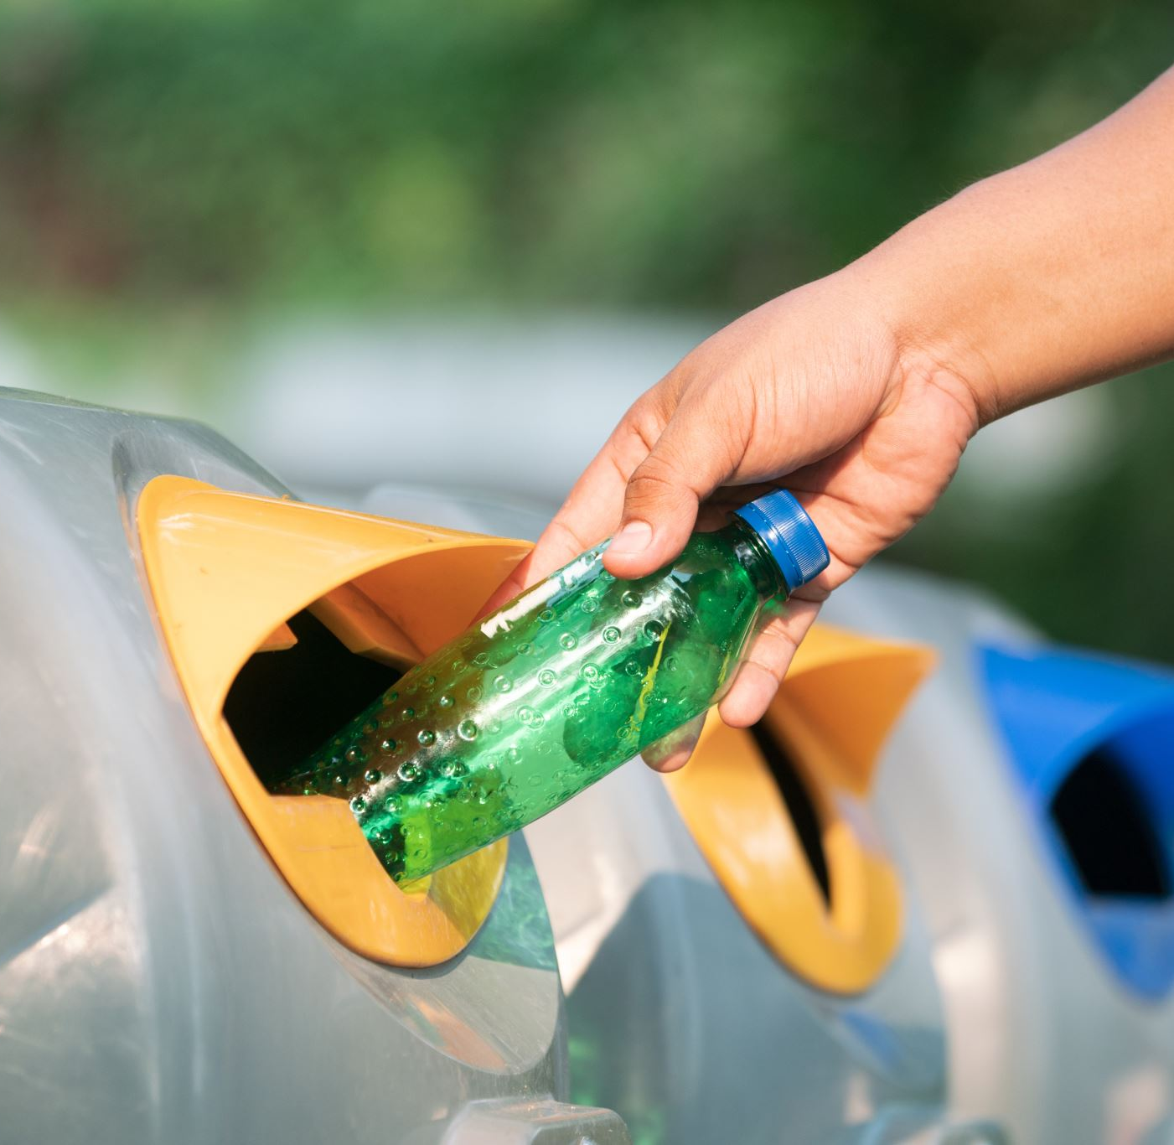
Public Attitudes towards the Waste Industry

Slide 4
Preconceptions Vs Reality
Disregard for “Bin Men” as people
Disregard of the need for properly separating waste
“It all goes into the same dump anyway"
"Just hide it under something else...."
2nd most dangerous workplace in UK
Mixed waste requires hand sorting
Over 90% of Binn Group Waste is Recycled
Reducung Landfill Reliance
Undeclared Hazardous Waste poses great risk to Staff

Slide 5
The challenges faced when dealing with a workforce of mixed ability

Slide 6
Fire Hazards and Zombies....

Slide 7
Lithium "Zombie" Batteries

Slide 9
Lithium Battery Fire – Aberdeen Recycling Plant

Slide 10
Human - Vehicle Interactions

Slide 11
Questions?

