Slide 2
SC Leslie Mason
Operations Function
Scottish Fire and Rescue Service

Slide 3
Zombie Batteries
‘Dud’ batteries thrown away in general waste or improperly recycled
May become damaged during collection, storing or processing
Ignition and/or explosion may occur within battery
Firespread to adjacent materials and buildings
Risk to employees, public and emergency responders (on and off site).

Slide 4
Credit: Eunomia

Slide 5
What is a Lithium Ion Battery?

Slide 7
Battery Types
Cylindrical (larger than AA battery)
Pouch
Prismatic (Rectangular shaped).
Notes:
Cylindrical – e bikes, power tools, laptops
Pouch – mobile phones, drones
Prismatic – Larger energy storage systems (BESS/DESS)

Slide 8
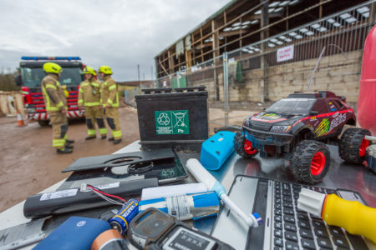
Credit: Viridor/SFRS

Slide 9
Positives:
Large energy in very small space (e.g. 1/10th of space required compared to lead acid battery)
Rechargeable
Greater energy density than other batteries.

Slide 10
Negatives:
Very energy dense comparative to size
First battery to not use water in electrolyte
If abused (overheating, penetration, overcharging) can ignite or explode
Many toxic and flammable compounds produced during thermal runaway
Fires burn for much longer, require large volumes of water and can reignite hours, days or even weeks later, and do so several times
Stranded electrical energy – electric shock, electrocution, arc flash explosion

Slide 11
Human Costs
Burns
Evacuation
Skin
Respiratory
Firefighting Operations.

Slide 12
Economic Costs
“Cutting Lithium Ion Battery Fires in the Waste Industry” – (Eunomia Research and Consulting, 2021)
48% of fires in the waste industry can be attributed to zombie batteries
Approx. 201 fires each year
Overall annual UK cost - £158 million
Waste Operators – 90%
FRS – 4%
Environment – 5%
Community – 1%

Slide 13
Credit: BBC

Slide 14
Reducing the Risk
Publicising and promotion of safe disposal methods
Amplification of key safety messaging
Site engagement with SFRS for operational intelligence gathering.
Notes:
Shops that sell more than 32kg of batteries a year (that’s around 345 four-packs of AA batteries) have to provide battery recycling collection facilities in-store.
Household batteries are accepted for recycling at your local recycling centre.
SFRS, RoSPA and Electrical Safety First are key partners in this. LiB working group.

Slide 15
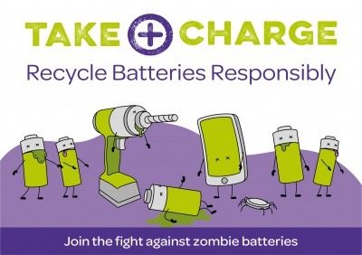
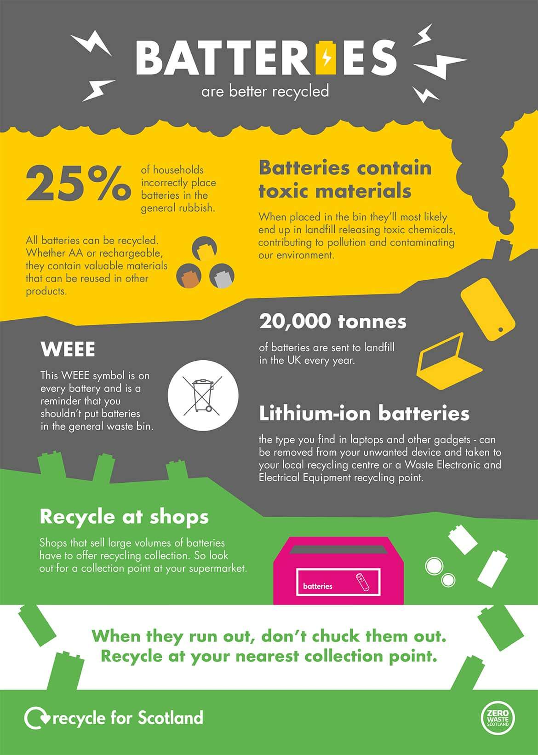
Zero Waste Scotland
Take Charge

Slide 16
Thank You

