Slide 1
Unintentional Injuries Publication
Stephen Bridgman and John Connor, Public Health Scotland
Cross Party Group on Accident Prevention and Safety Awareness
6th June 2023

Slide 2
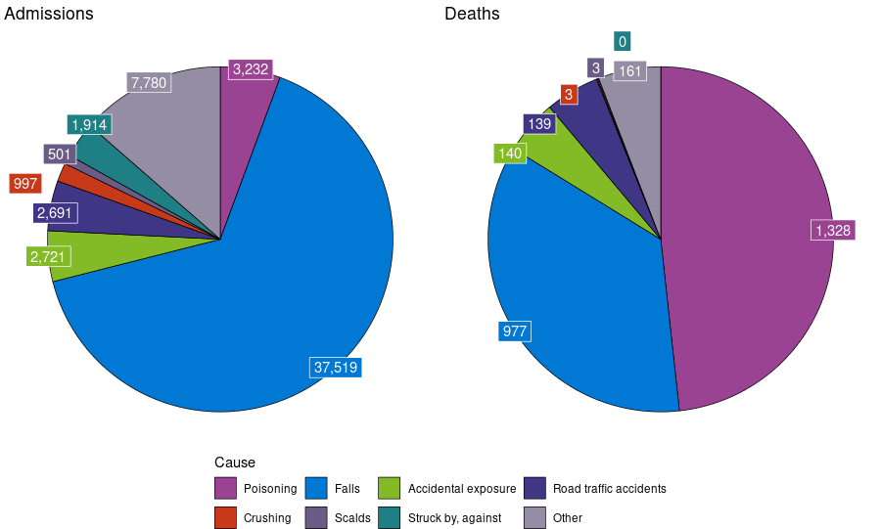
Summary
In 2021/22, there were just over 57,100 emergency admissions for unintentional injuries.
This represents 1 in 10 of all emergency admissions in Scotland.
In 2021, unintentional injuries led to 2,751 deaths.

Slide 3
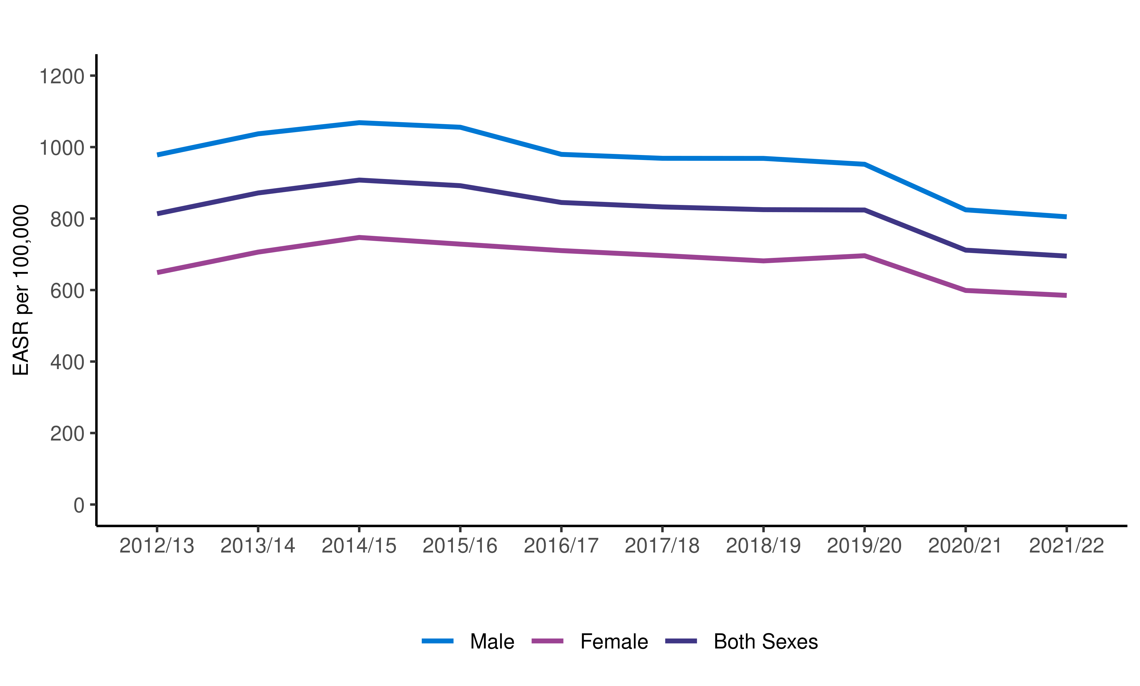
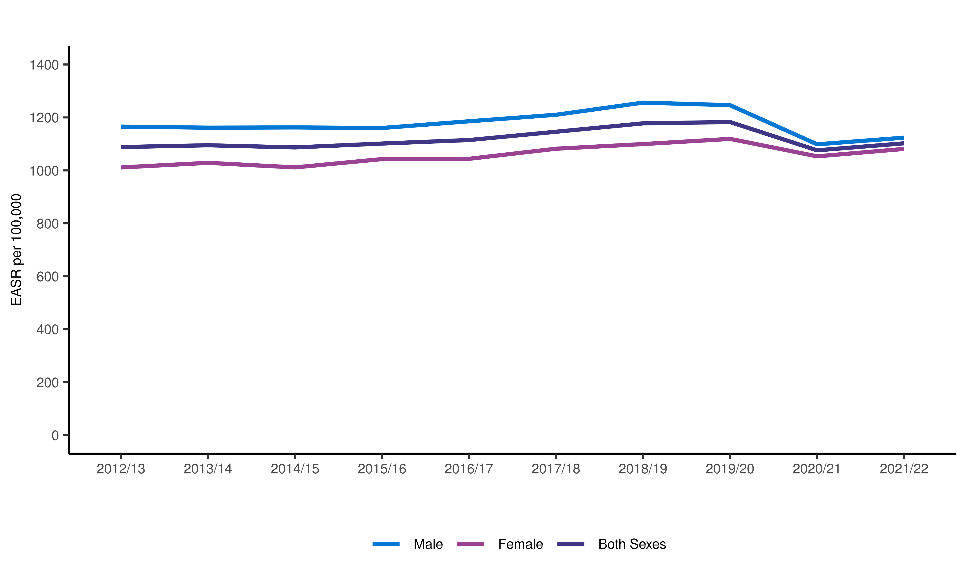
Emergency hospital admissions rates as a result of an unintentional injury by sex; year ending 31 March 2013 to 2022
Children, under 15
Adults, 15 and over

Slide 4
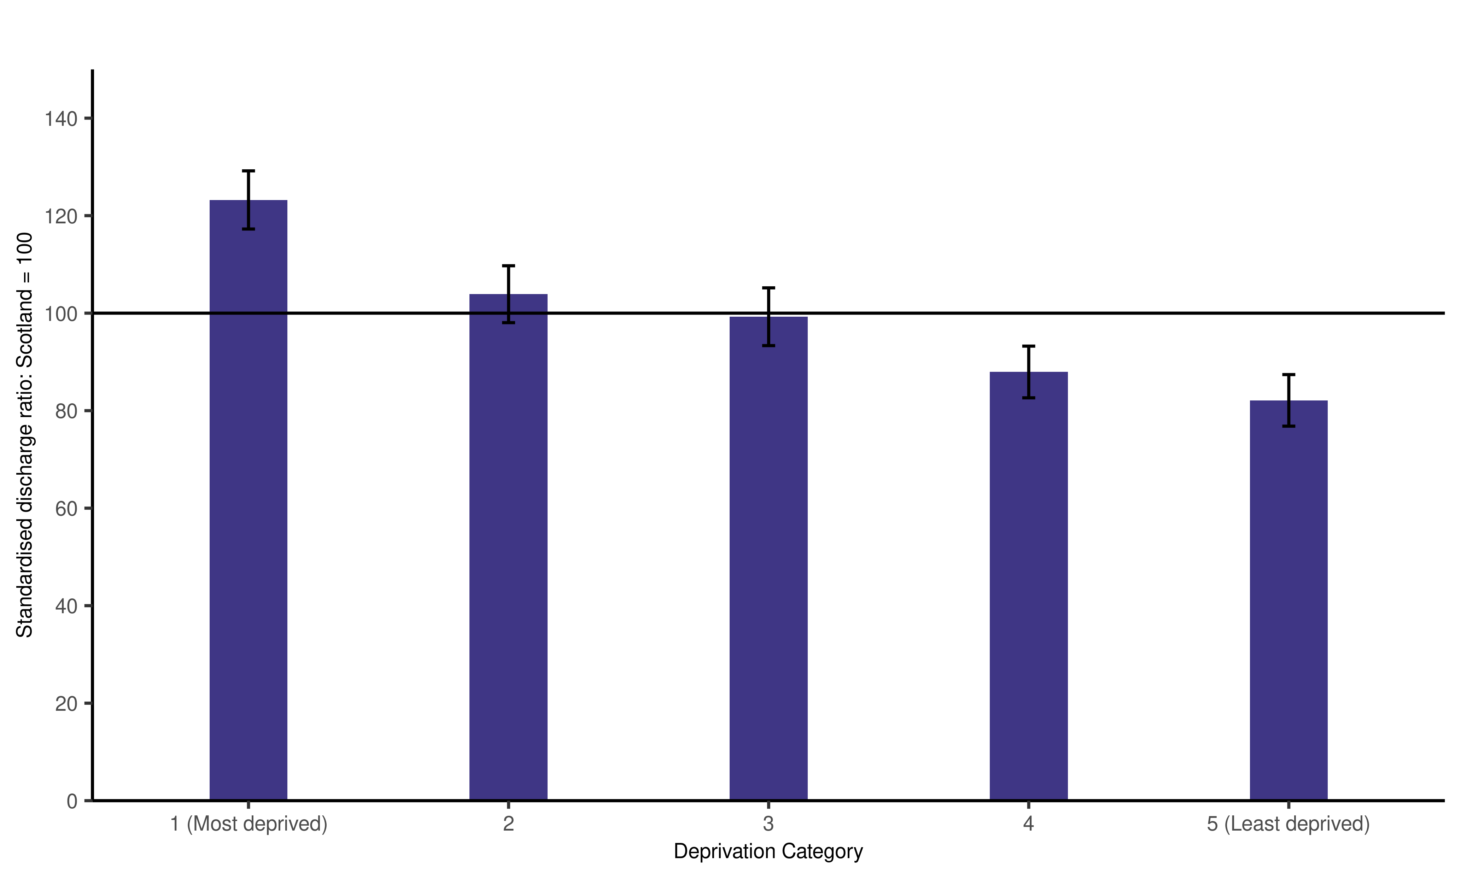
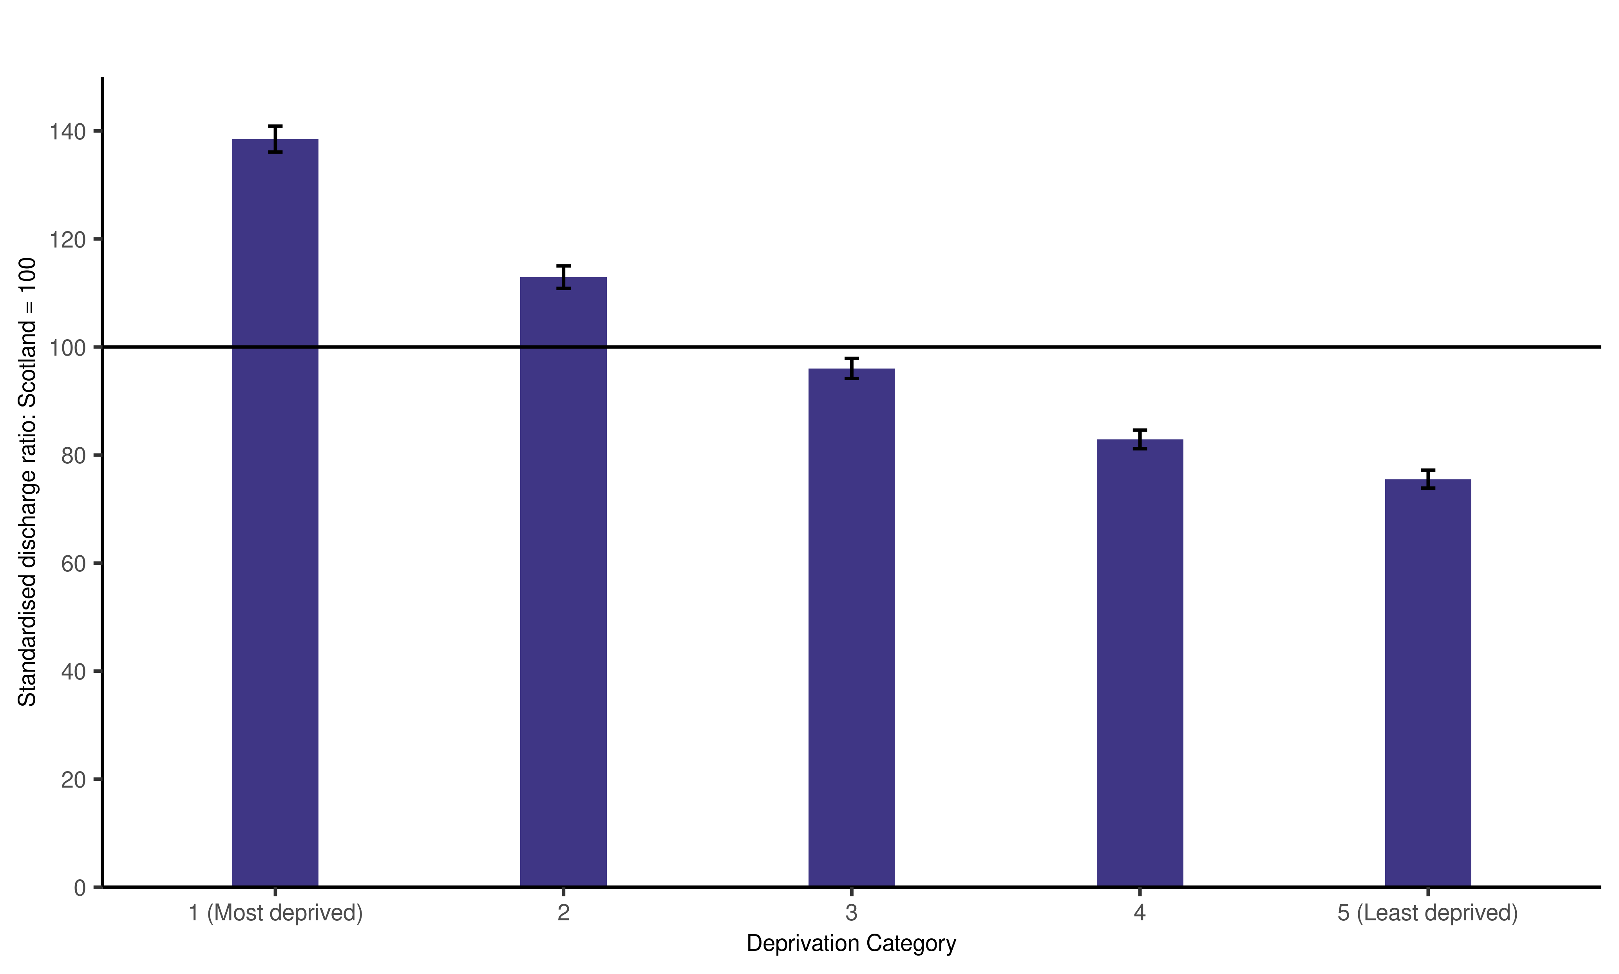
Emergency hospital admissions as a result of an unintentional injury by deprivation; year ending 31 March 2013 to 2022
Children, under 15
Adults, 15 and over

Slide 5
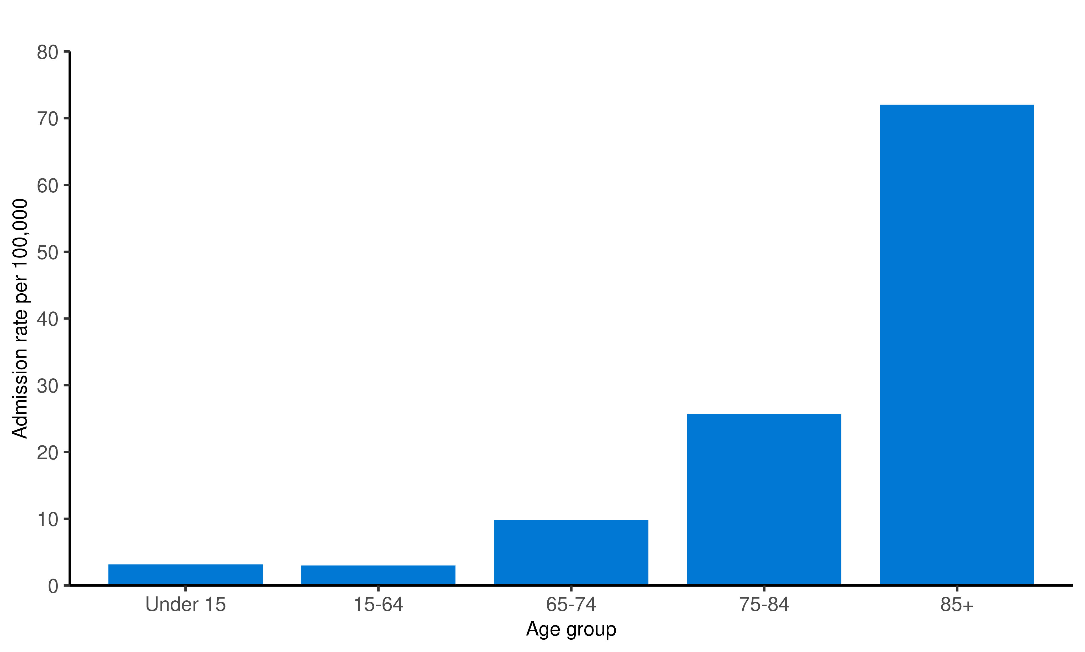
Emergency hospital admissions resulting from a fall, by age group, year ending 31 March 2022.
The rate of falls in those aged 65 and over has increased from 20.7 per 1,000 in 2012/13 to 22.5 per 1,000 in 2021/22. 87% of unintentional injuries in this age group were due to falls.

Slide 6
What improvements would make this publication more useful for your work?
Thank for your feedback
Please email
Stephen.bridgman@phs.scot.uk
With comments
Or to arrange a conversation with the team

