Slide 1
Water Safety Education
Cross Party Group on Accident Prevention and Safety Awareness
Child Safety
Tuesday 7th June 2022

Slide 2
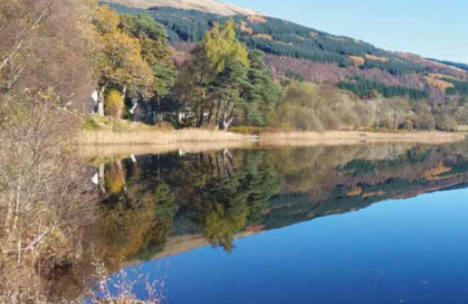

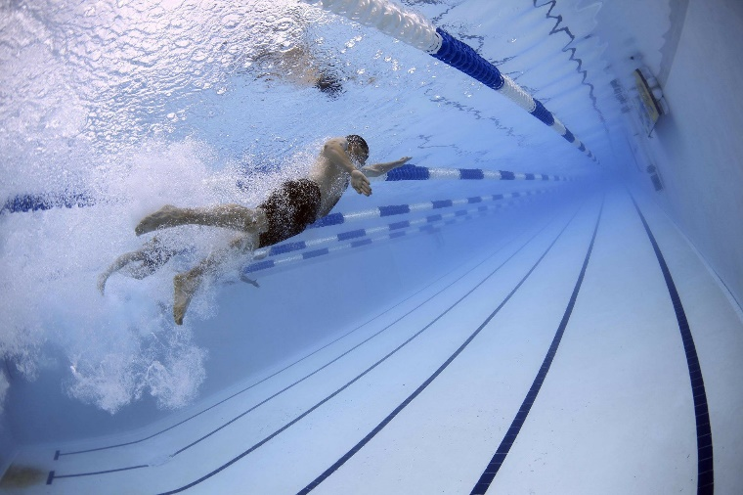
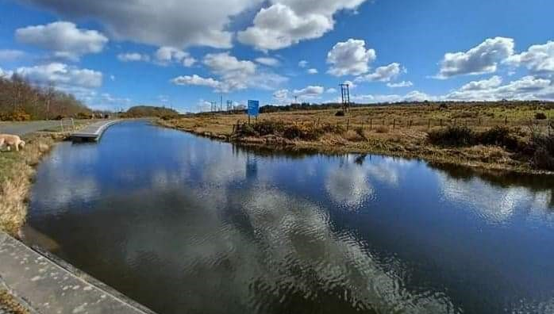
Activity 1
1.
2.
Do you ever visit a place similar to this (choose one)?
Where is it?
What do you do there?
Do you feel safe there?
What might the dangers be?
3.
4.
What are the differences between swimming in a pool and in the sea?

Slide 3

Overview
Introduction and background
The Scottish Context
The Water Safety Code
The Water Safety Progression Pathway
Curriculum for Excellence: Where does Water Safety Education sit?
National Improvement Hub

Slide 4
Introduction and background
Why Water Safety Education?
Fife Water Safety Group
We can’t do it alone: a collaborative determination
Water Safety Scotland: Education Subgroup

Slide 5

The Scottish Context of Water Safety
Increased opportunities for access to water.
Temperature of Scotland’s Waters and Cold-Water-Shock.
The Land Reform (Scotland) Act 2003.
Find out more at:
https://www.watersafetyscotland.org.uk/

Slide 6
Water Safety Code
Keep it clear and consistent
Encourages critical thinking

Slide 7
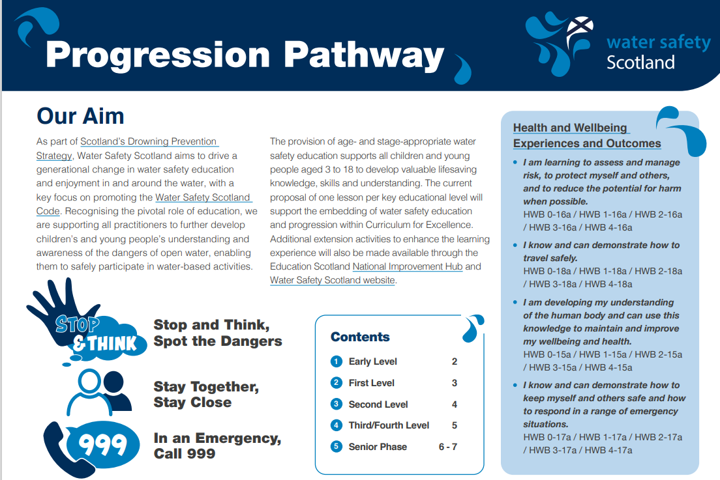
The Water Safety Progression Pathway
Supporting practitioners to support children and young people.
Age-and-stage-appropriate water safety education, from 3 – 18.
Lifesaving knowledge
Lessons, materials and extension activities.
Water Safety Code
Inclusive and accessible.
Free to use and download
First release (Third/Fourth Level resource) available in April.
Senior Phase released May
National Presentation released May.
All resource complete by December 2022.
National Improvement Hub
Water Safety Scotland

Slide 8
Health & Wellbeing Curriculum
Mental, emotional, social and physical wellbeing
Planning for choices and changes
Physical education, physical activity and sport
Food and health
Substance misuse
Relationships, sexual health and parenthood

Slide 9
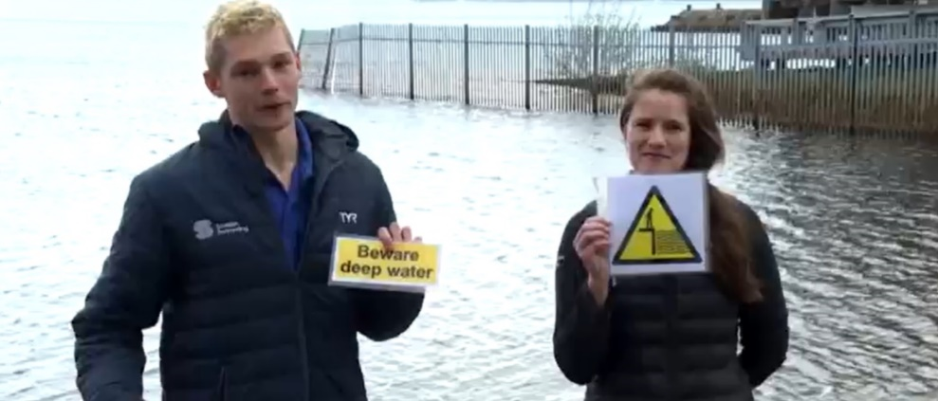
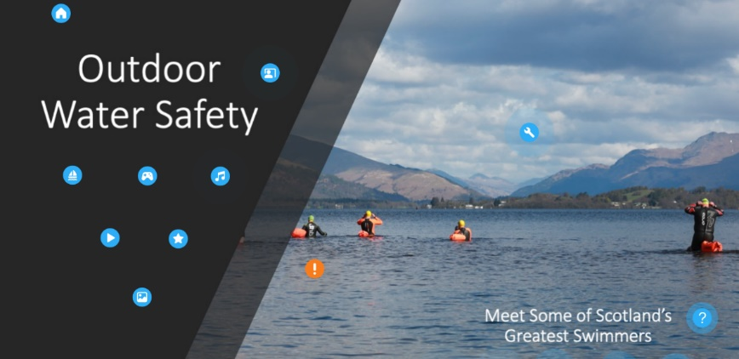
National Improvement Hub
Curriculum
Resources for each curricular level
E-Sgoil Water Safety Assembly
Digital learning space
Inclusion
Extra-Curricular
Resources for CLD practitioners
Outdoor education
Young Scot’s Entitlement Card

Slide 10


Thank you!

