Slide 1
Water Safety in Scotland
Education
Notes:
Introduce yourself and note that you are here to speak on behalf of Water Safety Scotland. Water Safety Scotland is a voluntary association of organisations and individuals. We provide advice and support to Scottish Government on matters of water safety and provide a standing network in Scotland to address water safety and drowning prevention. Right now we have 54 member organisations such as Scottish Water, SEPA, many recreational national governing bodies. WSS work is driven by the targets of Scotland’s Drowning Prevention Strategy (published in 2018) and the Water Safety Action Plan released in 2022 with the support of the Minister for Community Safety. Essentially this is to reduce the number of accidental drowning fatalities in Scotland.
Today is a short overview of the journey to introduce water safety education into the Scottish curriculum, supported by Scottish Government and Education Scotland.

Slide 2
Overview
Background
Strategic direction and policy
Where does Water Safety Education sit in the Curriculum for Excellence?
Process
The Water Safety Code
Task 1: The Water Safety Progression Pathway
Task 2: Water Safety Education Resources
Task 3: The National Water Safety Workshop
Next Steps
Notes:
Today we will be looking at the background to the development of water safety education in Scotland, including the strategic influence. We will look at where the water safety resources sit within the Curriculum for Excellence, and the various resources that are now available. Essentially, there is are two banks of resources. One is a general water safety workshop that is aimed to be used with young people aged 14+ that can be delivered by anyone working with this age group, such as community teams with Police Scotland and Scottish Fire and Rescue Service or any community group. There is also ice safety and alcohol and water safety workshops now available for these groups and we will further develop workshops that will improve knowledge and understanding with this age group. The other set of materials is the library of education resources that have been created to be used by teachers across the different curriculum levels, from nursery to S6. We will look at all of the available resources in some detail shortly and finally we will look at future directions for water safety education.

Slide 3
Background
On average, 96 people in Scotland lose their life in a water-related fatality each year.
Education Subgroup
Why water safety education?
We can’t do it alone: a collaborative determination
Whilst most fatalities and water-related incidents occur within the 40+ age range, the ‘Accidental Drownings in Scotland, Under 25’s’ analysis notes that:
“Over the last 5 years, the most common age range for accidental drownings was 20 – 24. The average age of an accidental drowning fatality within the under-25’s age group was 18 years.”
Accidental Drownings in Scotland, Under 25’s (Analysis of 2017 – 2021 WAID Data (Scotland)
Notes:
On average, 96 people in Scotland each year lose their life to drowning; Scotland has the highest rate of accidental drowning of all the UK nations.
Water Safety Scotland’s Education subgroup was tasked to address the educational targets of Scotland’s Drowning Prevention Strategy, specifically to: “Drive a generational change to facilitate greater safety education and enjoyment in and around water”. Through a range of core outputs the aspiration is to provide better outcomes for communities and increase understanding of the dangers of water so that Scotland’s waterways can be enjoyed safely. Some of the reasons that we need to ensure water safety education are:
Scotland has increased opportunities for access to water: we have approximately 30,000 lochs and a coastline of around 12km, covering roughly 60% of the UK’s entire coast.
The average UK sea temperature rarely gets above 15 degrees centigrade – this only gets colder further north in Scotland, leading to a potentially higher risk of suffering from cold water shock when entering the water.
The Land Reform (Scotland) Act 2003 enables people to enjoy the great outdoors with much less restricted access than our UK neighbours
Work that informed development of the national water safety workshop was in a large part through the Fife Water Safety Group which involved organisations and individuals including Gillian Barclay, who sadly lost her son to drowning and since then has campaigned to raise awareness and reduce accidental drowning. Such work is emblematic of the strength of collaborative efforts to reduce water related injury and fatalities.
Although the data points to the age group 40+ as the most likely to have a water-related fatality or serious incident, a report conducted by WSS which looked only at the under 25 years age range between 2017 – 2021 showed the most common age range for accidental drownings was 20 – 25 years. The average age of an accidental drowning fatality within the under-25’s age group was 18 years. We therefore view water safety education with our children and young people as a vital element in reducing drownings, to improve knowledge to enable them to make more informed and safer decisions when in and around water.

Slide 4
Strategic direction and policy
Drowning is the 3rd leading cause of unintentional injury death worldwide, accounting for 7% of all injury-related deaths. (World Health Organisation)
This has been recognised by the UN, with the declaration of World Drowning Prevention Day to be held annually on the 25th July. (United Nations)
Support to address drowning prevention from the Scottish Government through the Water Safety Action plan has been essential to underline the importance of preventative initiatives.
Collaboration with Education Scotland led to the development and implementation of Water Safety education within the Curriculum for Excellence.
Scotland’s Drowning Prevention Strategy:
Reduce accidental drowning deaths in Scotland by 50% by 2026 and reduce risk amongst the highest risk populations, groups and communities
Contribute to the reduction of water-related suicide
WSS Education Subgroup: “Drive a generational change to facilitate greater safety education and enjoyment in and around water”.
Notes:
Accidental drowning has been classified by the World Health Organisation as the third leading cause of unintentional injury death worldwide. To raise awareness and provide a platform for global advocacy of drowning prevention, the United Nations has designated 25 July World Drowning Prevention Day. WSS, along with partners, uses this day to run a water safety open day, with the primary intention of raising awareness of water safety, particularly among children and young people.
Following a spate of tragic drownings in Scotland in July 2021, and in response to a more general movement towards drowning prevention, the Scottish Government gave support to Water Safety Scotland via investment and the release of the Water Safety Action Plan by the Minister for Community Safety in March 2022. This release led to the development and implementation of water safety education within every stage of the Curriculum for Excellence. The development of these resources also supports that key target of Scotland’s Drowning Prevention Strategy, specifically to ‘drive a generational change to facilitate greater safety education and enjoyment in and around water’.

Slide 5
Where does Water Safety sit in the Curriculum for Excellence?
Curriculum for Excellence
The Heath and Wellbeing Curriculum
The Health and Wellbeing Curriculum supports learners to…
Mental, emotional, social and physical wellbeing
Understand and develop their physical skills;
Participate in a wide range of activities which promote a healthy lifestyle, one of which may be swimming.
In relation to water safety, the Health and Wellbeing Curriculum supports learners to effectively “assess and manage risk and understand the impact of risk-taking behaviour”.
Planning for choices and changes
Not statutory and therefore is for teachers, head teachers and other professional education practitioners to decide the development and implementation of the curriculum within the overall framework.
A national approach to learning and teaching for young people aged 3 – 18 in Scotland, and is underpinned by the values of wisdom, justice, compassion and integrity.
Notes:
Education Scotland is the national improvement agency for education in Scotland.
One of the functions of Education Scotland is to lead and support successful implementation of the Scottish Curriculum.
Curriculum for Excellence (CfE) is the national approach to learning and teaching for young people aged 3 to 18 in Scotland and is underpinned by the values of wisdom, justice, compassion and integrity.
The curriculum, which has been implemented in schools since August 2010, is not statutory and therefore is for teachers, head teachers and other professional educational practitioners to decide the development and implementation of the curriculum within the overall framework
We are specific about the need for children and young people to gain knowledge appropriate to their age and stage of education.
For each curriculum area, CfE has experiences and outcomes which set out what each pupil is expected to learn and how they are expected to progress through four levels of learning.
The Health and Wellbeing Curriculum enables the provision of a broad range of physical activities appropriate to the schools context.
Swimming and other water-based activities is one possible context schools can use to deliver some of experiences and outcomes for Physical Education, Physical Activity and Sport – an organiser in the Health and Wellbeing curriculum.
In relation to water safety, this area of the curriculum supports learners to effectively “assess and manage risk and understand the impact of risk-taking behaviour” therefore it makes sense that water safety education should sit in the HWB area of the CfE

Slide 6
Process:
Planning
Scoping out what can be created and when
Development of Resources
Progression Pathway development
Liaising with experts and piloting with young people.
Creation and development of resources
Promotion of Resources
Communication Plan
Key Stakeholders and platforms
Water Safety Code to form golden thread linking all resources with core messaging
Evaluation: Evaluation planned for publication in late 2023 which will take into account the opinions of teachers, children and young people.
Notes:
Since March 2022 and the release of the Ministerial Water Safety Action Plan, there has been a real momentum in progress for the WSS education subgroup and development of the resources. These stages show steps in the process from inception to release of the resources.
Planning: Working with Education Scotland (and supported by the Scottish Government) we were given the go ahead to develop a range of resources for all levels of the Curriculum. This provided us with a valuable opportunity to create meaningful, high quality lessons which would help inform young people and start those conversations that enable critical thinking on risk, safety and welfare. The core messaging of the water safety code is the golden thread which can be found throughout the all of the resources. The idea being that consistency will lead to familiarity and hopefully retention of the information.
The development of resources - what is the progression pathway? It maps out learning opportunities, key words, questions, potential activities for each level. This was the chunkiest bit of the puzzle to get right as it informs the development of the each curriculum level resource, extension activities and other materials. This involved reaching out to experts and stakeholders – most notably children and young people - who have played a critical role through focus groups in providing honest feedback on the resources. Liaising with experts such as Education Scotland, particularly around welfare considerations, and assistance from WSS partners was integral to creating the suite of resources, including new videos, guidance for practitioners, extension activities, lesson plans and PowerPoint presentations.
Promotion of resources: key to success – linking with a specific comms plan. Liaising with teachers, promoting through Twinkl Scotland and partner social media accounts to signpost to the resources,. Next step is evaluation of the resources – we want to know they are being used and crucially what teachers and pupils think of them. Evaluation report due to be published end 2023 and will inform next steps.

Slide 7
Water Safety Code
Clear and consistent
Applied to all levels of WSS resources
Notes:
As mentioned, the Water Safety Code is a three-step, easy-to-remember code which has been applied to all levels of the water safety resources and the national workshop.
The consistency of message is incredibly important to reinforce core safety messaging. We are very pleased to report that the water safety code is also being incorporated into the school swimming lessons framework, meaning that there will be consistency between classroom and practical learning.

Slide 8
Task 1: The Water Safety Progression Pathway
Supporting practitioners to support children and young people:
Age-and-stage-appropriate, from 3 – 18.
Lifesaving knowledge
Lessons, materials and extension activities: mainly discussion based.
Inclusive and accessible.
Free to use and download
National Improvement Hub
Water Safety Scotland
Notes:
A key part of the planning process, the progression pathway maps out water safety education from early level through to the senior phase. This is essentially the blueprint for the national water safety workshop and the various curriculum levels and as mentioned was created in collaboration with children and young people.

Slide 9
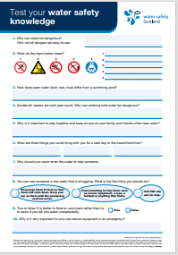
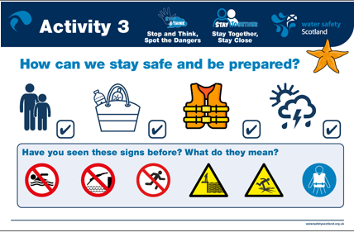
Task 2: Water Safety Education Resources
Teacher resources
Notes:
As mentioned, core water safety education resources have been developed and implemented for every stage of the Curriculum for Excellence – early level, first level, second level, third and fourth level and senior phase. This covers the nursery (aged 3) up to S6 (aged 18) and each stage resource consists of a lesson plan, PowerPoint presentation and extension activities to support the core learning. These resources are freely-available to teachers (or anyone) on the WSS website and Education Scotland National Improvement Hub.

Slide 10
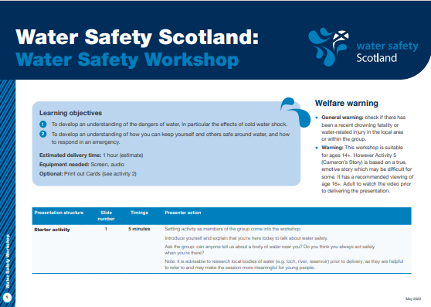
Task 3: The national water safety workshop
Notes:
Again as mentioned, the national water safety workshop is designed to be used with young people aged 14+ and can be delivered without the need for prior knowledge of the subject or a teaching background. For example the national workshop can be used by youth groups, community engagement officers with Police Scotland and Scottish Fire and Rescue Service to deliver stand-alone water safety sessions within school or community settings. There is also an ice safety workshop and alcohol and water safety workshop that can be used by and for these groups aged 14+

Slide 11
Next steps
Evaluation
Reflection and continuous improvement
Non –Mainstream Learners
SEN Students
Inclusivity
How can we ensure our resources are inclusive, accessible and meaningful for all young people, including underrepresented groups?
Learners in non-mainstream settings
EAL Learners
Involve young people as part of this process
Who can we involve in this process?
Collaborate with University interns for evaluation
Notes:
We want to ensure that the water safety resources are received well by teachers and pupils alike, therefore the resources will be independently-evaluated by students at Abertay University via qualitative interviewing.
We also want to ensure that non-mainstream learners can benefit from the important messages within the water safety resources, and hope to develop these for use within non-mainstream educational settings.
We are very proud to be the first (and still only) UK nation to have water safety education embedded into the national curriculum and hope that these resources can be used for years to come to improve skills and knowledge relating to water safety among our children and young people.

Slide 12
Thank you

