Slide 1
What can we learn from “Safe at Home”: effectiveness and cost-effectiveness of England’s national safety equipment scheme
Professor Denise Kendrick
University of Nottingham, UK
denise.kendrick @nottingham.ac.uk

Slide 2
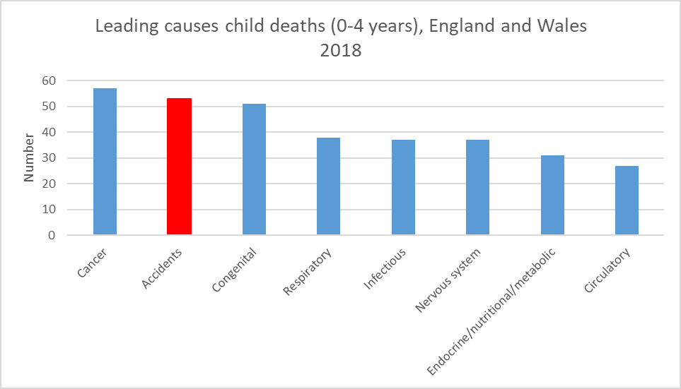
Unintentional injury is a leading cause of death in 0-4 year olds

Slide 3
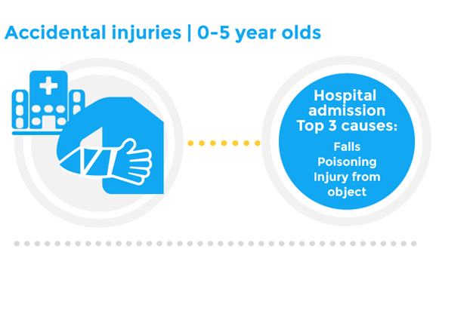
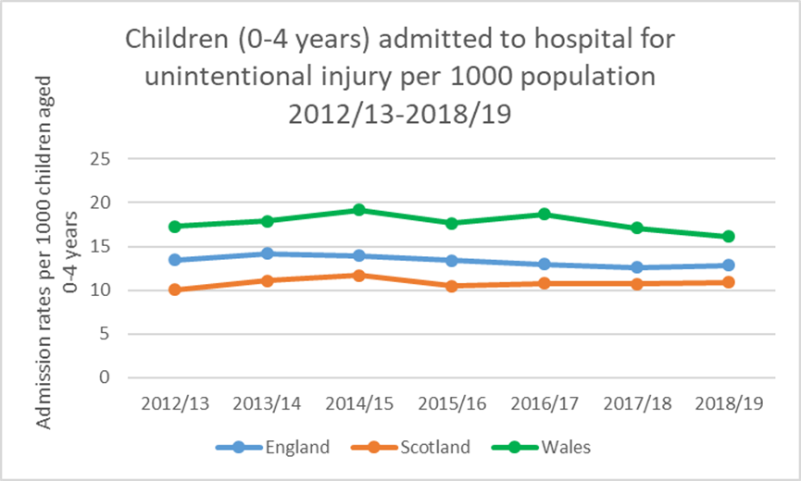
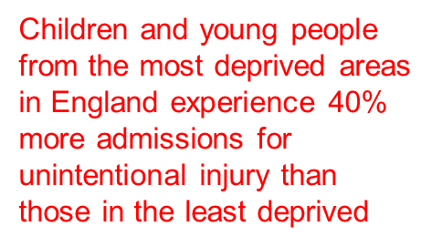
Unintentional injury places large burden on health services

Slide 4
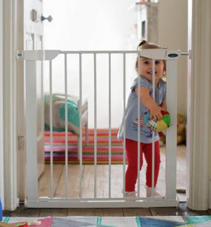
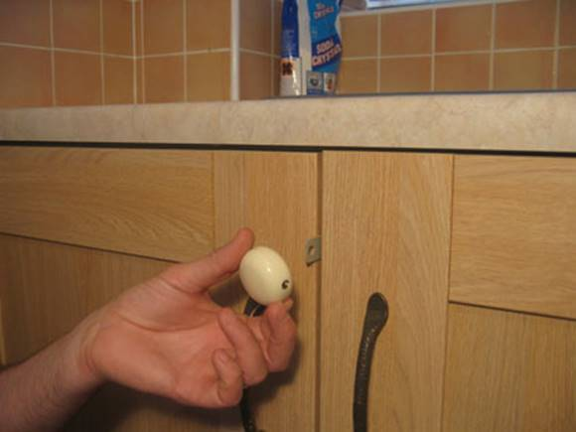
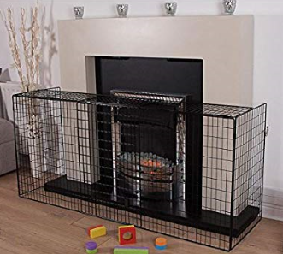
Background
Avoidable injuries are a significant health problem
Disproportionate effect on:
Safe at Home safety equipment scheme
Government funded national scheme in England (£11m), 2009-2011
Independent Evaluation
Good reach
Children under 5 in the home
Steep social gradients with higher injury risk with greater disadvantage
Children <5yrs
Acceptable to families and professionals
But unknown impact on injury rates
Managed by RoSPA*
Mixed methods
Effectiveness, efficiency, acceptability
Aimed at households
130 local authority areas with >national hospital admission rates for injury <5 years
Surveys, interviews, case studies, observations
Equipment costs quantified
Staff training, free safety equipment fitting + education
High quality training
Effectively managed
Low income families
Most are preventable
*Royal Society for the Prevention of Accidents

Slide 5
Methods
Objectives:
Assess impact of Safe at Home on hospital admission rates for injury
If effectiveness varied by the amount of equipment fitted
Evaluate cost-effectiveness
Study design:
Controlled interrupted time series analysis:
Compared changes in injury rates in areas where Safe at Home operated (intervention areas) and areas without Safe at Home (control areas)
Took account of differences in injury rates in intervention and control areas before Safe at Home and seasonal variations

Slide 6
Methods
Mapped equipment fitting data onto small geographical areas of 1000-3000 people* to identify intervention areas
Identified control LSOAs (no Safe at Home in England or from Wales)
Matched each intervention LSOA to one control LSOA based on injury rates before Safe at Home (2004-2008), rurality and deprivation scores
Compared changes in hospital admission rates for injuries before, during, 1-2 years after and 3-4 years after scheme (2004-2015)
Same analysis categorised by number of items of equipment fitted
*Lower Super Output Areas (LSOAs)
Total number of LSOAs available for matching
27,991
Final number of LSOAs in analyses
18,932
Intervention LSOAs
9,466 (100% England)
Control LSOAs
9,466 (88% England)

Slide 7
Equipment fitted
Cumulative percentage of installations
Type of safety equipment | Number (%) of families provided with each type of equipment | Total number of items provided (% of total)
Any safety equipment | 64,590 (97.9%) | 493,510 (100.0%)
Safety gate | 56,894 (86.2%) | 106,986 (21.7%)
Cupboard locks* | 51,459 (78.0%) | 92,287 (18.7%)
Window restrictors* | 24,773 (37.6%) | 88,638 (18.0%)
Corner cushions* | 44,404 (67.3%) | 80,683 (16.3%)
Bath/shower mat | 54,188 (82.1%) | 54,432 (11.0%)
Fire guard | 34,009 (51.6%) | 35,852 (7.3%)
Cord winders* | 18,670 (28.3%) | 34,632 (7.0%)
No equipment (advice only) | 1,380 (2.1%) | 0 (0.0%)
17 months
* = supplied in packs
Median=4 types of equipment
Median=7 items of equipment

Slide 8
Characteristics of children included in the study
Baseline (Jan 2004-March 2009) | Intervention | Control
Mean population of 0-4 year olds | 942,391 | 911,097
Mean percentage of population (male) | 51.2 | 51.2
Age at hospital admission 0 1 2 3 4 5 | 13,618 (17.9) 20,235 (26.6) 17,691 (23.2) 13,394 (17.6) 10,801 (14.2) 390 (0.5) | 12,499 (18.7) 17,715 (26.4) 15,330 (22.9) 11,487 (17.1) 9,669 (14.4) 315 (0.5)

Slide 9
Trends in injury rates before, during and after SAH in intervention and control areas
Reduction increased as the amount of safety equipment increased
8% reduction
over 2 years
P=0.422
P=0.007
P=0.001
P=0.345
Before
During
Yrs 1-2
Yrs 3-4
Adjusted for baseline injury rates, seasonality

Slide 10
Cost-effectiveness analysis: Methods
Had three time periods:
Implementation (April 2009-March 2011)
1st follow up (years 1-2 after scheme)
2nd follow up (years 3-4 after scheme)
Aggregated LSOAs to local authority level
Applied healthcare costs using National Tariffs
Outcome was number of injuries avoided
Same analysis as for main study:
Compared changes in admission rates over time in intervention and control local authorities
Compared changes in hospital costs over time in intervention and control local authorities

Slide 11
Results
 |  | Implementation | Years 1-2 | Years 3-4
Monthly average hospital admission rate per LA (per 10,000 children) | Control Intervention | 12.009 13.920 | 12.286 13.799 | 12.156 13.521
Difference in monthly hospital admission rate per LA | Control Intervention |  | 0.278 -0.121 | 0.147 -0.399
Reduction in monthly hospital admission rate in intervention LA compared to controls |  |  | 0.399 | 0.546
Monthly average hospital expenditure per LA | Control Intervention | £6,254 £13,370 | £6,427 £13,053 | £6,008 £12,200
Difference in monthly hospital expenditure per LA | Control Intervention |  | £173 -£317 | -£245 -£1,170
Intervention LA savings in monthly hospital expenditure compared to controls |  |  | £490 | £924

Slide 12
Hospital admission rates
Reduction in monthly hospital admission rates in intervention LA compared to controls:
Years 1-2 = 0.399/10,000 children
Years 3-4 = 0.546/10,000 children

Slide 13
Hospital admission costs
£490
£924
Implementation
Years 1-2
Years 3-4

Slide 14
Health economics summary
Monthly cost of SAH per local authority = £3,224
Savings on admission expenditure for every pound spent on SAH:
Years 1-2 compared to implementation period = £0.15
Years 3-4 compared to implementation period = £0.29
Cost per admission averted:
Years 1-2 compared to implementation period = £6,862
Years 3-4 compared to implementation period = £4,209

Slide 15
Conclusions
Significant reduction in injury admissions in 0-4 year olds for two years after providing and fitting equipment
Areas where the most equipment was fitted had the greatest reductions in injury rates
Intervention cost > savings in healthcare
Analysis underestimates benefits:
Excluded A&E attendances, primary care, minor injury units, walk-in-centres
Included only short term healthcare costs
Wider costs to society not included (long-term social care, education, lost productivity)
No data on quality of life

Slide 16
Policy implications
Develop and implement Scottish guidelines with recommendations in line with NICE PH30 ‘Unintentional injuries in the home: interventions for under 15s’
Determine types of household with children at greatest risk of unintentional injury
children aged under 5, rented or overcrowded conditions, low income, properties lacking safety equipment or where hazards have been identified
Prioritise at risk households for home safety assessments, supply and installation of home safety equipment
Ensure long-term funding for safety equipment schemes
Schemes take time to establish
Staff skills/knowledge lost when short-term funding ends
Injury rates return to pre-scheme levels 2 years after scheme ends

Slide 17
Thank you
denise.kendrick@nottingham.ac.uk
Acknowledgments
Funding: NIHR School of Primary Care Research - https://www.spcr.nihr.ac.uk/
Research team: Trevor Hill, Dr Elizabeth Orton (PI), Professor Denise Kendrick, Professor Carol Coupland, Dr Ed Tyrrell, Dr Matthew Jones
External steering group: Dr Michael Watson, Professor Sarah Lewis, Sheila Merrill

Slide 18
Trends in injury rates before, during and after the SAH scheme in SAH and control areas
By equipment density
8.9% reduction (high density)
7.7% reduction (medium density)
6.5% reduction (low density)

