Slide 1
Water-related fatalities
Scotland, 2018 - 2023

Slide 2
Note
The following data and analysis comes direct WAID 2018 – 2022. Drowning and Incident Review (DIR) data is used where stated
Suicide Fatalities refers to Suspected/Confirmed suicides; accidental refers to accidental/natural causes.
It should be noted that the core data providers continue to improve verification and completeness of records starting in 2012 which results in an improved record set.

Slide 3
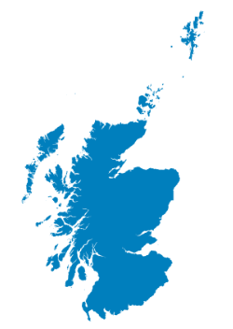
96

Slide 4
Key headlines
The total number of water-related fatalities in Scotland in 2022 was 96
The introduction of DIR in 2023 will help reduce the number of ‘not recorded’ in the future
There were 45 accidental fatalities in 2022

Slide 6
Overall

Slide 7
Accidental

Slide 8
Accidental rate

Slide 9
Comparisons

Slide 10
Location and activity

Slide 11
Age and sex

Slide 12
Accidental via month

Slide 13
DIR data will provide a very enhanced data set. Already, we can say:
Preliminary outcome data (known as a Scene and Outcome Review – SOR) has been captured in 100% of known incidents
13 DIR’s have been held meaning recommendations and measures have been considered

