Slide 1

Ice Safety:
Water Safety Workshop

Slide 2
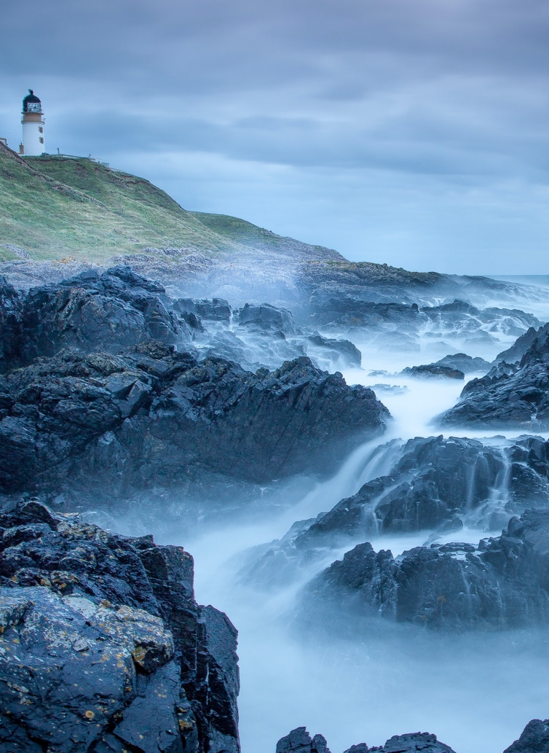
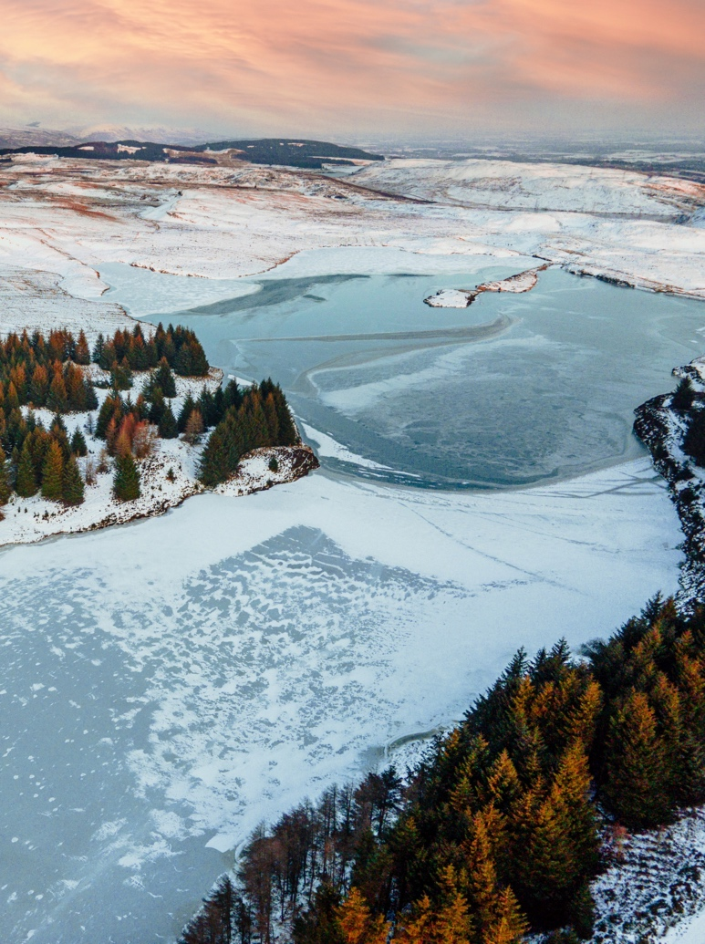
Starter activity
Think of a body of water near you – it could be a river, loch or beach.
How does it differ by season?
Not all risks are easy to see which can be very dangerous.
Can you think of any?

Slide 3
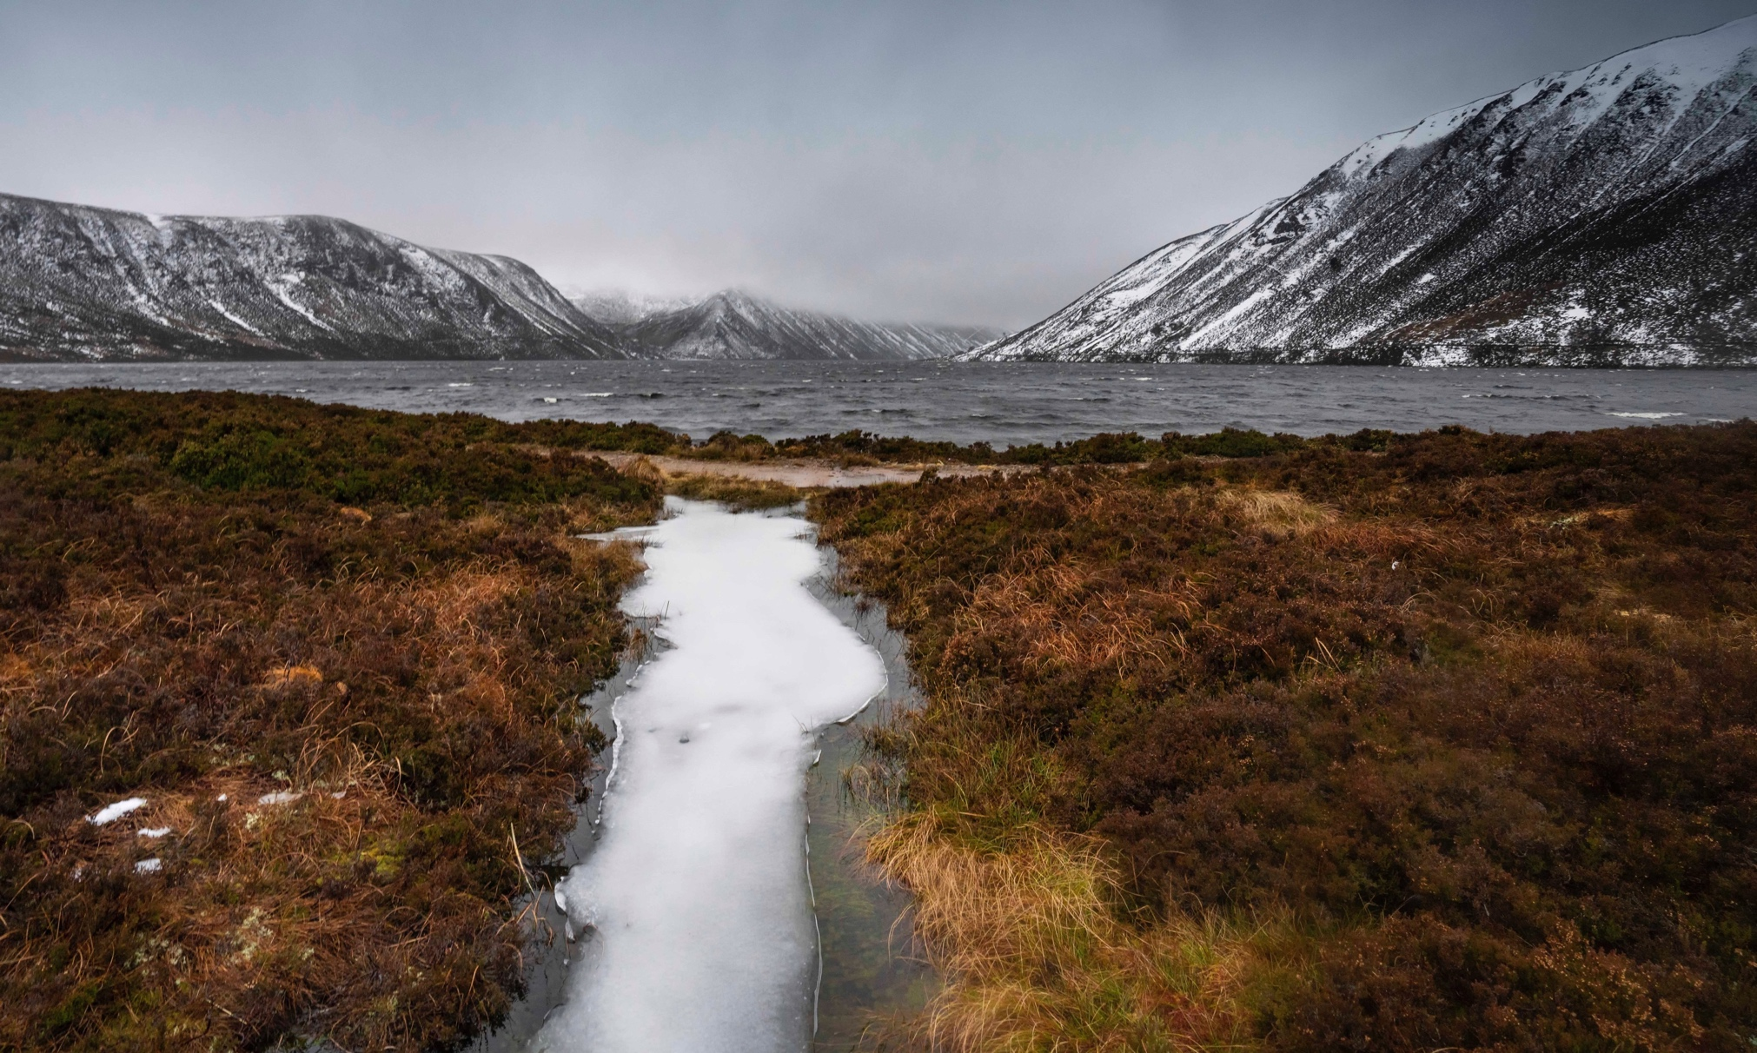
Learning objectives
Objectives:
To develop an understanding of the dangers of water, in particular frozen water.
To develop an understanding of how you can keep yourself and others safe around water, and how to respond in an emergency.
Notes:
Learning objectives
Today, we’ll be talking about water safety in winter – in particular, ice safety. Water can be fun but also dangerous, and sadly every year people are injured or drown in Scotland’s waters. Today, you’ll learn some simple tips to help keep yourself and others safe in and around water.
Activities on or near water can be fun, but you need to make sure you stay safe.
Scotland has an incredibly large coastline, as well as thousands of inland lochs, rivers, reservoirs and canals. Activities on or near the water are important for staying fit and getting outside.
We’re not here to frighten anyone away from enjoying activities near or on water, but to tell you some simple steps to identify dangers, keep yourself and others safe, and how you should respond in an emergency

Slide 4
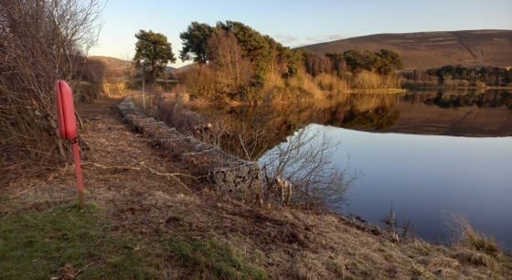
Activity 1 Stop and Think, Spot the Dangers
You and two friends are taking your dog on a walk
by the loch
It’s important to Stop and Think, Spot the Dangers
when you’re near water.
Can you see any dangers in this picture?
What dangers might be hidden?
It’s important to identify where you are and if there is rescue equipment near you. How could you get help if you got into trouble here?
What type of information might be near water to help warn you of potential dangers?
Notes:
We want you all to learn an important three-step message to keep you safe – the Water Safety Code. The first step in the Water Safety Code is to Stop and Think, Spot the Dangers. It’s important to stop and think so that you can spot potential dangers when you’re near water. Most people who need to be rescued never intended to be in the water in the first place. Note also that potential dangers change with the seasons.
I want you to imagine you and two friends are taking your dog for a walk by a loch. Have a look at the photo and think about the following:
1 Can you see any dangers in this picture (Prompts if needed: water could be cold/deep/fast/contaminated –
there is no way of telling by looking. Also there is a drop at the water’s edge – stay away from the edge?)
2 What dangers might be hidden? (Prompts – hidden objects under the surface, moving craft on the water, also cold, fast, deep contaminated water can’t be seen)
3 How could you get help if you got into trouble? Here, it’s important to identify where you are and if there’s rescue
equipment or an appropriate adult near you. (Prompts – signage with location/mobile phone location/What3words) For challenge question – water safety signage, and symbols on there.
If possible, ask a couple of individuals to volunteer to share their ideas. Reinforce the main dangers to be aware of:
● The water is colder than you think● The water is deeper than you think● The water can be fast moving and powerful
● There can be hidden dangers in the water
● The edge can be dangerous

Slide 5
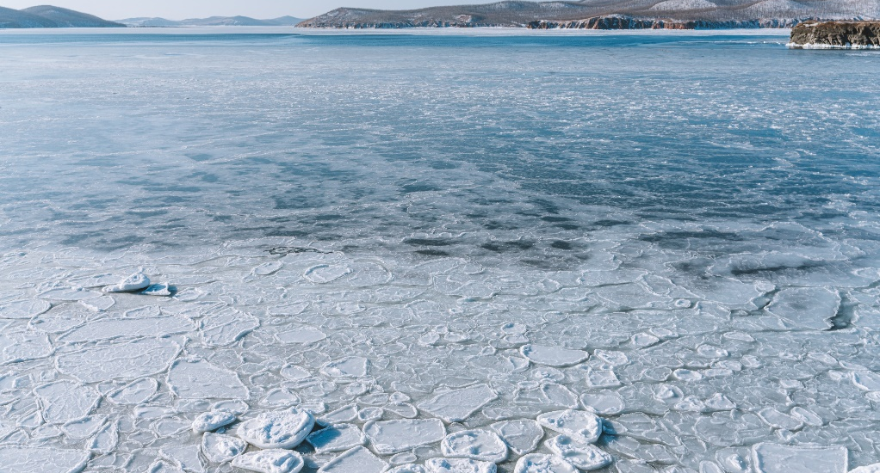
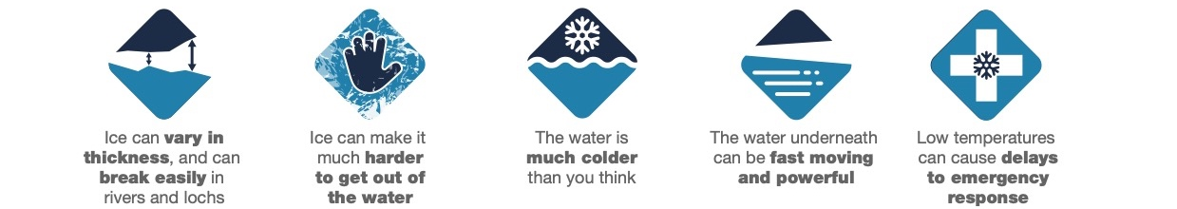
Activity 1 Stop and Think, Spot the Dangers
You and two friends are taking your dog on a walk
by the loch on a very cold winter’s day.
It’s important to Stop and Think, Spot the Dangers
when you’re near water.
Can you see any dangers in this picture?
What dangers might be hidden?
It’s important to identify where you are and if there is rescue equipment near you. How could you get help if you got into trouble here?
Do you think there could be a delay to emergency response on a very cold day?
Notes:
Key message: Keep off frozen water, as you have no way of knowing if it will hold your weight or how deep the water beneath is. Make clear that the dangers can be different in winter.
I want you to imagine the same scenario with this second photo. Have a look at the photo and think about the following:
1 Can you see any dangers in this picture? Use bullet points below for prompts during discussion if necessary.
2 What dangers might be hidden?
3 How could you get help if you got into trouble? Again, it’s important to identify where you are and if there’s rescue equipment or a lifeguard near you.
If possible, ask a couple of individuals to volunteer to share their ideas.
Reinforce the main dangers to be aware of:
● Ice can vary in thickness, and can break easily in rivers and lochs ● Ice can make it much harder to get out of the water
● The water is much colder than you think● The water underneath can be fast moving and powerful ● Low temperatures can cause delays to emergency response
Answer to challenge question: Yes there may be a delay – icy road and underfoot conditions may delay emergency responders reaching the scene

Slide 6

Activity 2
When do accidents happen?
Unfortunately people lose their lives in water at different times of year.
Can you guess when most accidents happen?
We will go through the cards: hands up if you think the number will be higher,
or hands down for lower (amount of people injured/drowned).
Note: Scotland data only 2017 – 2021, WAID
Notes:
Key message: Water-based accidents happen all year round, not just in summer.
Unfortunately, people lose their lives every year in different bodies of water. Water can be dangerous all year round, but can you guess when most accidents happen?
We will go through the cards: Put your hands up if you think the number will be higher, or hands down for lower (number of people injured/drowned).
Note: These figures refer to Scotland only (2017–2021 WAID data).
Click through the cards. Option: Print out the cards and ask for volunteers to come up to the front. Ask them to arrange the cards in ascending order by number of water-related fatalities by season. You can ask them how they came to this order/decision.
Summer is the season that sees the most water-related fatalities – but winter, spring and autumn have significant numbers, too. Ask the group if they find this surprising.
Key message: We need to take care in and around water all year round, and especially near frozen water in winter.
Remind the group of the key dangers, which include: ● Ice breaks easily● There is no way of knowing how deep the water beneath is● Cold water/cold water shock● Powerful and moving water
● It’s more difficult to get out from ice

Slide 7
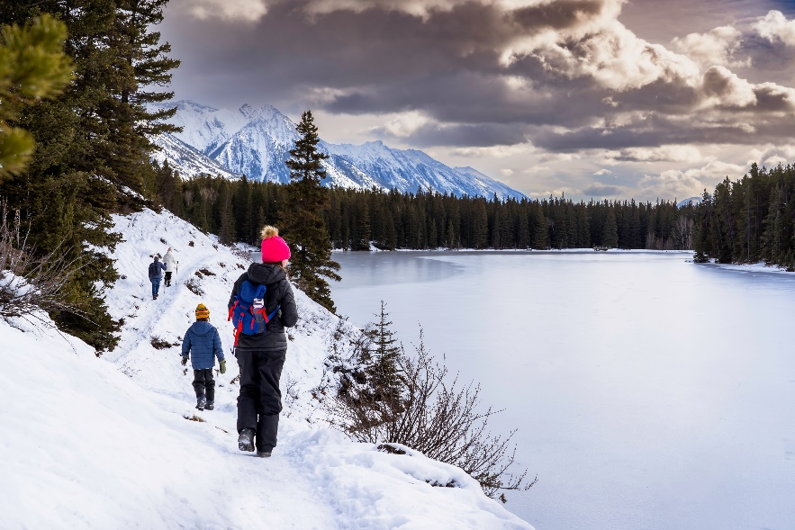

Activity 3 Stay Together, Stay Close
If you are going on your own near water, what could you do to keep safe?
Planning for a day out can help you keep safe: what could you bring with you?
Why is it important to look out for others when near water?
Notes:
The second key message to keep yourself and others safe is to Stay Together, Stay Close. Ask the group to think about why they might be safer in a group.
Why is it important to look out for others when you’re near water? (Prompt: if one person gets into trouble, there will be others there to help and raise alarm, if on your own near water, tell someone where you’re going/when you’ll be back.) Planning for a day out can help keep you safe – what could you bring with you?
It’s important to:
● tell someone where you’re going, and when you’ll be back,
● bring a mobile phone with you,
● be prepared – plan your trip and take everything you may need,
● check the weather forecast in advance and wear the right clothing.
Click to reveal answers after discussion has taken place.

Slide 8
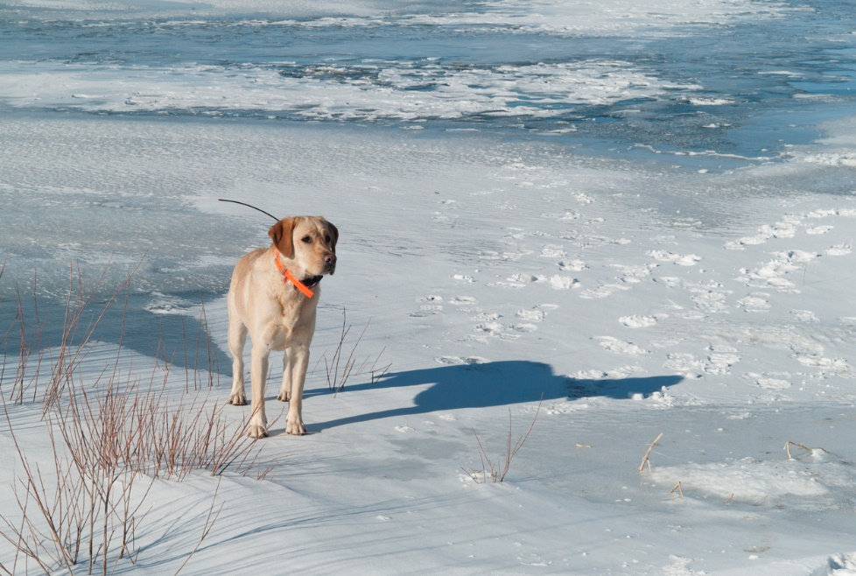
Activity 4 Stay Together, Stay Close
What should you avoid doing with your dog near water?
What could you do to keep your dog safe near water?
What should you do if your dog is stuck on the ice?
Notes:
Look at this photo of a dog by the cold icy water. Why do you think it’s important to keep your dog on a lead and by your side?
Sadly, we hear numerous stories of dogs falling through ice and their owners attempting to rescue them – only to get in trouble themselves.
To protect yourself and your dog:
● always keep your dog on a lead near frozen water,
● avoid throwing sticks or balls for them to retrieve when you’re near the ice, ● never go onto the ice to rescue a dog – move to a place on land that the dog can get out and call to them from a safe place.
Click to reveal answers after discussion

Slide 9
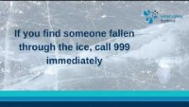
Activity 5
Why should you never go into the water to help someone?​
What would you do if someone encouraged you to walk on frozen water?
Notes:
If you see someone in trouble on the ice, it’s important to know how to react. The Scottish Fire and Rescue Service is likely to attend rescues at inland sites, such as icy lochs and cold rivers.If you’re in a situation where you need to contact the emergency services, try to remain calm so you can give vital information about the scenario and location.
Play the video clip, which tells the group their role in an emergency and includes key safety information.
Reiterate the following:
● Never enter the water or go onto the ice to save someone.
● In an Emergency, Call 999.
● After calling for help, try to help the person using rescue equipment that may be available, or throw them something
that floats (e.g. a football). Reassure them that help is on the way and try to get them to stay calm and float

Slide 10
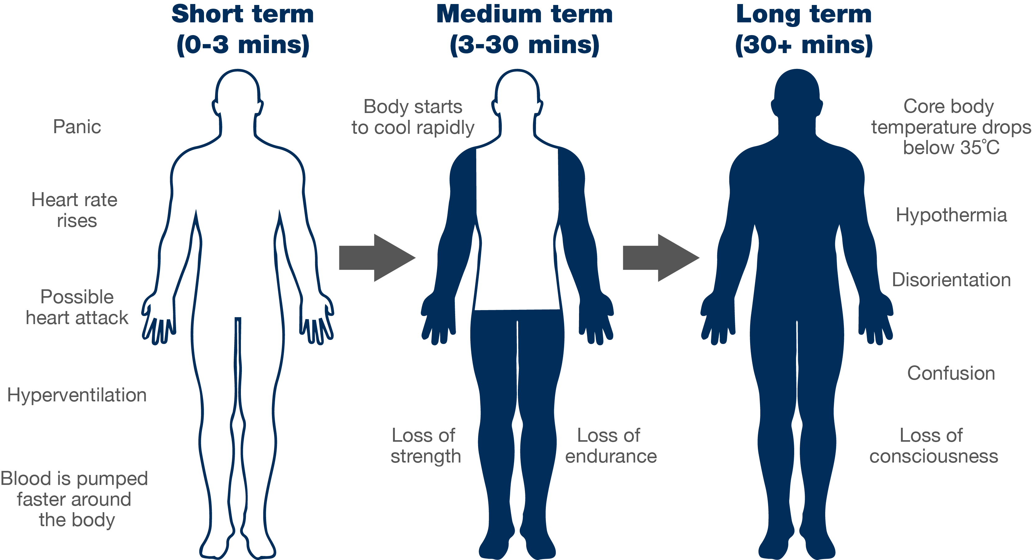
Cold water shock
Notes:
Key messages: Don’t go onto frozen water. When you’re near water, particularly in winter, be aware of the effects of cold water shock
Why are Scotland’s waters particularly dangerous? Anything below 15°C is defined as cold water and can seriously affect your breathing and movement. So, the risk in Scotland’s waters is significant most of the year, and even more so with the freezing temperatures in winter. The UK and Ireland average sea temperature is around 12°C. There’s always a very real risk of cold water shock in Scotland’s waters, and in winter the effects of cold water shock and hypothermia can develop very quickly. Go through the diagram, which shows the effects of cold water shock on the body in the short term (0–3 minutes), medium term (3–30 minutes) and long term (30+ minutes).
You could ask the following questions:
● Is anyone surprised by the effects of cold water shock at the various stages?
● What would you do to calm yourself down?
● How could calming down increase your chance of survival?
● How could floating save your life?

Slide 11
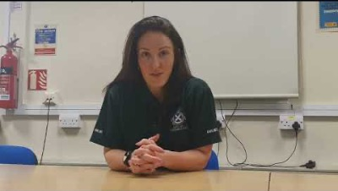




What should you do if you get into trouble in the water?
Important advice from Gemma Lightbody,
Scottish Ambulance Service
How would you react?
What emotions might you feel?
How would your body feel?
Key points:
Call 999 if you have a mobile on you
Instead of panicking, Float on your back
After you have calmed down shout loudly for help
If you can – attempt to swim to shore or find something that floats
Notes:
We’ve spoken about what to do if you see someone in the water who needs help. But you also need to know what to do if you’re the one that needs help.
Play the video of Special Operations Team leader in Scottish Ambulance Service, Gemma Lightbody, discussing cold water shock. After the video, reiterate the following:
● Call 999 and ask for the emergency services
● Try not to panic – instead of trying to fight the water, lie back and extend your arms and legs to help you float
● Float for 60 seconds or so until you’ve calmed down and adjusted to the temperature of the water
● When you feel you can, shout loudly and wave for help
● Try to swim to land or grab something that floats
● Professional medical assistance will always be required, even if the person feels ok
Ask the participants to ‘act out’ floating by standing (or lying on the floor, if possible) with their arms stretched out, legs relaxed and head back. Explain that by floating, rather than attempting to fight against the water, you’ll be able to calm down, get used to the temperature of the water, slow down your breathing, and then make a decision to either:
1 Swim to the shore or something that floats 2 Put one hand up in the air and shout for help

Slide 12
Activity 6
Have you learned the Water Safety Code?
Think of that same body of water again.
Not all dangers are visible: think of two that you can’t always see.
What two actions should you take if you see someone in trouble in the water?
What should you do if you find yourself in water unexpectedly?
How would you challenge dangerous behaviour you see?
Notes:
Return to the original images and ask the group to look at the images on the screen again.
Ask them to reflect on the questions – would they change their responses now? Would they now act differently around water, and do they feel more confident in knowing how to stay safe and appropriately respond to an emergency? What have you learned about what you should and shouldn’t do around frozen water?
To address question 3 – advise to challenge positively and to give the reasons WHY it is dangerous

Slide 13
Notes:
Summarise, or ask the group to summarise, the three-step Water Safety Code:
● Stop and Think, Spot the Dangers
● Stay Together, Stay Close
● In an Emergency, Call 999
To gauge understanding, ask pupils:
Why should you never attempt to enter the water to help someone?
Who do you call in an emergency?
Which three things can you do to stay safe near water?
Why can some dangers be hidden?
If you fall into cold water, what should you do?
Direct them to further information at:
www.watersafetyscotland.org.uk

Slide 14


