Slide 1
Injury Surveillance in Scotland: Health Service Contribution
Stephen Bridgman (Clinical lead for injury),
with John Connor, Sandra Storrie, and Emma Doyle Public Health Scotland
Cross Party Group on Accident Prevention and Safety Awareness
6th February 2024

Slide 2
Our purpose
As Scotland’s national public health body,
Public Health Scotland leads and supports work to
Prevent disease
by providing vaccines and reducing the spread of infectious diseases
Prolong healthy life
supporting access to high quality healthcare
Promote health
by strengthening the building blocks of health for all

Slide 3
Long-term investment in prevention: every sector has a role
Scottish Government
Local Government
Health and Social Care
Communities and Third Sector
Business
Wider Public Sector
Notes:
Creating the building blocks we needs for a healthy society go beyond the NHS.
PHS believes that every sector has a contribution to make to primary prevention.
In the short-term, progress can be made on maxmising the impact of the public sector as anchor organisations, but that’s just a start.
Longer-term we need to redesign the way the system works, pulling our collective resources to provide the best possible services for Scotland’s communities.

Slide 4
Outline of Talk
Injury surveillance
What it is and why is it important?
What is clinical coding?
ICD coding
What is coded data used for
Available Health datasets
PHS publications
Home Injury: Some figures
Priorities for improvement?

Slide 5
What is injury surveillance and why is it important?
Injury the major cause of death in people under 35y in Scotland
Injury the major cause of years of life lost under 75y in Scotland
If you cannot measure it you cannot manage it well!

Slide 6
What is clinical coding?
Clinicians use many different terms for the same diagnoses when writing clinical notes.
When identifying how many patients have a particular condition, text recorded in notes presents difficulties when trying to count and compare diagnoses.
Instead, consistent codes are applied for the same condition, making analysis easier.

Slide 7
What is Coded Data Used For?
Helps maintain clinical standards
Helps with financial control
Helps with injury surveillance to help prevent problems

Slide 8
Available Health datasets PHS managed that contain injury data
NHS Hospitals
Admissions
Accident and Emergency Attendances
Primary Care
In-hours Services
Out of Hours Services
Pharmacy
Scottish Ambulance Service
NHS 24

Slide 9
Hospital Admissions
Scotland invest in clinical coders who code hospital admissions
Coders use World Health Organisation (WHO) International Classification of Diseases codes (ICD 10) for diagnoses, external causes, intent
Coders use Office of Population, Censuses and Surveys (OPCS 4) codes for operations
Coding of data is good and can be used for National Statistics

Slide 10
Hospital Admissions in Scotland 2021-22 and 2022-23
Year | 2021-22 | 2022-23
Hospital Admissions | 1,060,041 | 1,092,413
Emergency Hospital Admissions | 570,857 | 557,681
Emergency Injury Hospital Admissions c 1 in 100 Scots admitted every year | 57,272 | 54,709

Slide 11
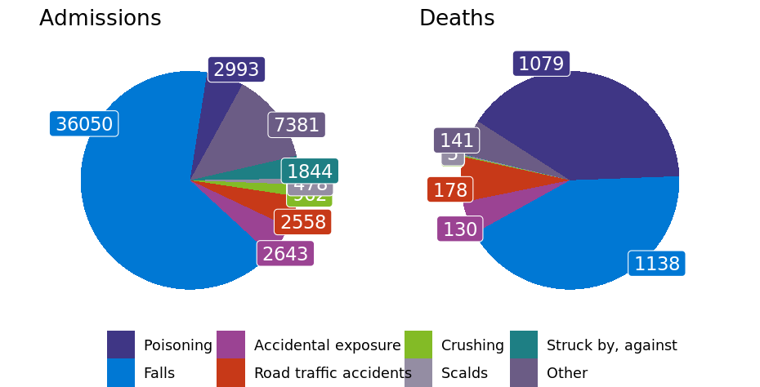
PHS Annual Unintentional Injuries Report 2022-23, events and external causes of injury, Scotland
54,709 emergency admissions for unintentional injuries, about 10% of all emergency admissions
In 2022, unintentional injuries led to 2,677 deaths.

Slide 12
Location of hospital admissions for injury caused by a fall (N=36050), Scotland 2022/23, all sexes

Slide 13
Hospital admissions for an injury occurring in the home children 0-4years, 2010-11 to 2022-23 (numbers)

Slide 14
Hospital admissions for an injury occurring in the home, older adults 75y and over, (numbers)

Slide 15
Hospital admissions for an injury occurring in the home, main diagnoses, 2022/23 (numbers)

Slide 16
Hospital admissions for injury from dog bite or strike (W54), occurring in the home, 2013/2014 to 2022/23 (numbers)

Slide 17
NHS hospital admissions for all unintentional injuries by deprivation quintile, 2022/23 (standardised discharge ratio)

Slide 18
What is theoretically possible given the quality and depth of data held.
SMR01 Hospital admissions is available from to 1980-2023
More specific causes of injury can be presented e.g. Drownings
Exploring presenting more detailed injury location data;
Home
Residential institute
Street and highway
School, other institution and public administrative area
Sports and athletics area
Industrial and construction area
Farm
Other specified places
Unspecified place

Slide 19
Annual Unintentional injuries reports – analysis of hospital admissions, and deaths

Slide 20
Consistently around 1.5/1.6 million attendances each year
Proportion of attendances from injury is unknown, as data quality is poor

Slide 21
Accident and Emergency (A&E) data issues & opportunities
Issues
Different coding systems used by different hospitals
Coding usually carried out by front line staff instead of dedicated coders
Data quality too poor for PHS to be able to use to publish statistics
Opportunities
Public Health Scotland have funded 3 very short term pilots to look at improving coding in 3 emergency departments
If coding improves then Scotland might use A&E data for prevention

Slide 22
Priorities for improved surveillance
A&E Data
Needs investment to improve coding so data is usable
Will enable targeted prevention
Is likely to be an invest to save investment for the public sector overall
Is likely to reduce hospital pressures and reduce injury in Scotland
https://www.google.com/search?sca_esv=c5c757c13b9f06cb&rlz=1C1GCEB_enGB1047GB1047&sxsrf=ACQVn08Zq6tWbifMmml-uVYo7JMh6CugJg:1707167096335&q=child+injured+from+blinds&tbm=isch&source=lnms&sa=X&ved=2ahUKEwiVoOWCjZWEAxUe9wIHHWcxBtYQ0pQJegQIDBAB&biw=853&bih=373&dpr=2.25#imgrc=VRZXUA8N28DXiM

Slide 23
Thank you!
Thank you for listening
Any queries or suggestions for improvement or work you may wish done please contact
Stephen.bridgman@phs.scot, Consultant in Public Health, Public Health Scotland

Slide 24
Appendix 1 – Injury type codes for hospital admissions
Emergency Admission Type*
32 - Patient injury - road traffic accident
33 - Patient injury - home incident
34 - Patient injury - incident at work
35 - Patient injury - other injury

