Slide 1

Ice Safety:
Water Safety Workshop

Slide 2
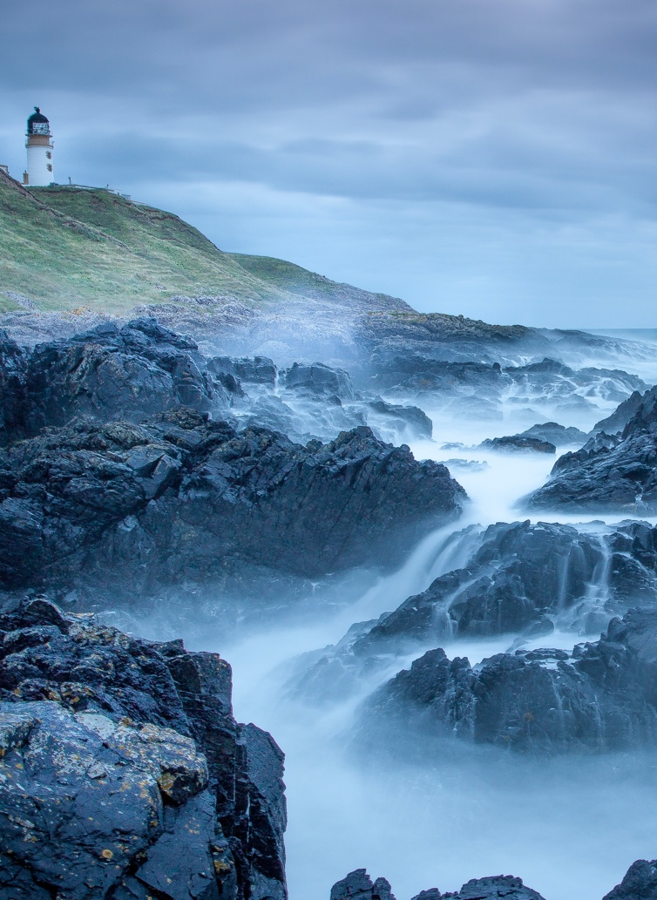
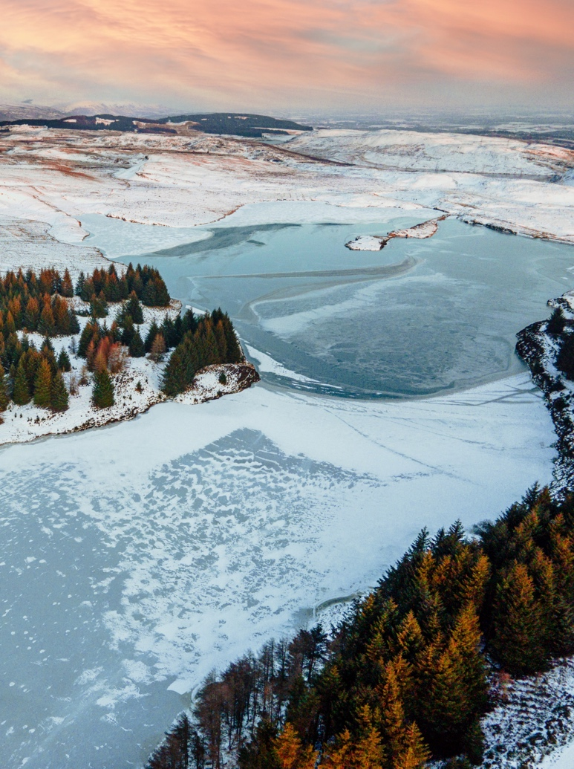
Starter activity
Think of a body of water near you – it could be a river, loch or beach.
How does it differ by season?
Not all risks are easy to see which can be very dangerous.
Can you think of any?

Slide 3
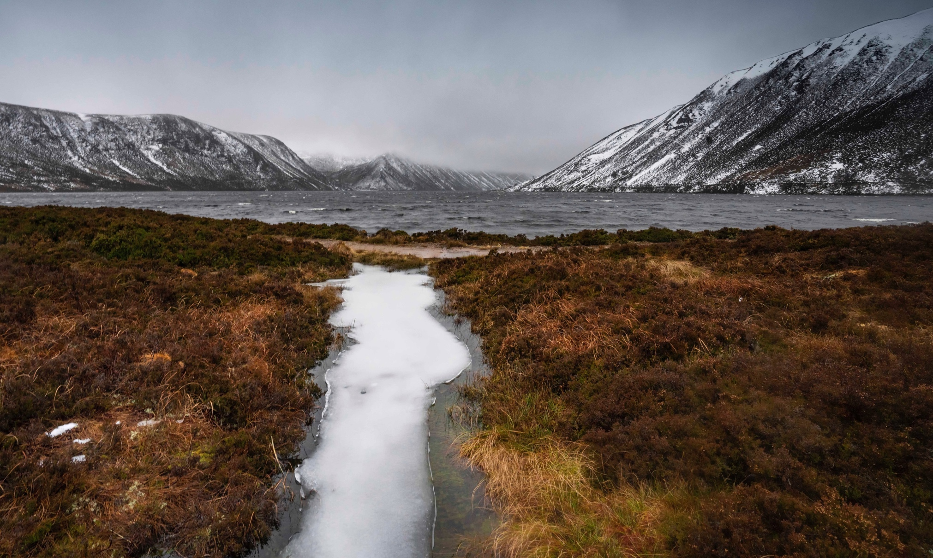
Learning objectives
Objectives:
To develop an understanding of the dangers of water, in particular frozen water.
To develop an understanding of how you can keep yourself and others safe around water, and how to respond in an emergency.
Notes:
First Slide: Activity 1
This slide should be shown as students enter the assembly hall or classroom. Ask students to spend a couple of minutes thinking about a place local to them (or somewhere they have visited) where there is open water.
You could give them an example of a local loch, river or beach, in order to set the scene and place the topic into a meaningful and relatable context.
‘Ask students the following questions:’?
What do you enjoy about the water?; Have you every felt unsafe near or in water?; How might water be dangerous?
Ask pupils to think about the challenges: What are the differences between swimming in a pool and in the sea?
Why are some hazards not visible or clear to see? What are they?
Why can water be dangerous?

Slide 4
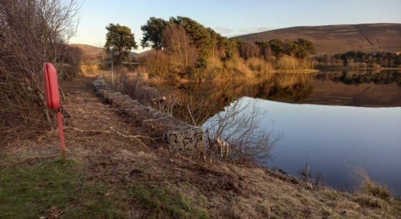
Activity 1 Stop and Think, Spot the Dangers
You and two friends are taking your dog on a walk
by the loch
It’s important to Stop and Think, Spot the Dangers
when you’re near water.
Can you see any dangers in this picture?
What dangers might be hidden?
It’s important to identify where you are and if there is rescue equipment near you. How could you get help if you got into trouble here?
What type of information might be near water to help warn you of potential dangers?
Notes:
Read out the statement and explain to pupils that they need to think carefully about it.. They need to be able to justify their answer.
1 = totally agree
10 = totally disagree
Take feedback from a couple of students. Ask them to share and compare their risks. Would one student do what the other did?
Key terms:
Hazard: ‘something with the potential to cause harm’
Risk: ‘the likelihood of that potential harm happening’

Slide 5
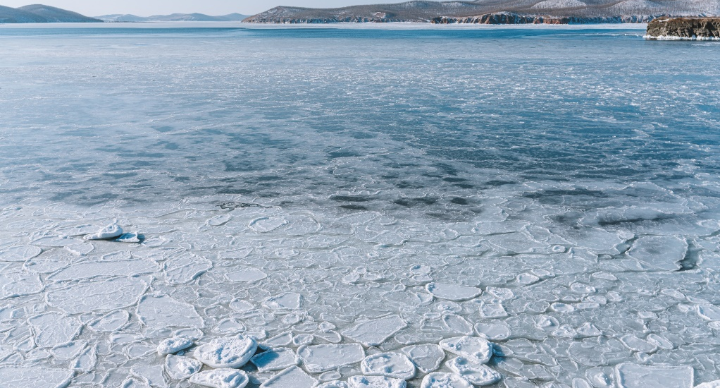
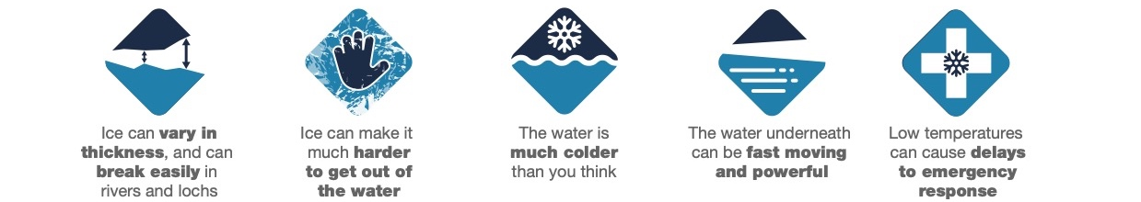
Activity 1 Stop and Think, Spot the Dangers
You and two friends are taking your dog on a walk
by the loch on a very cold winter’s day.
It’s important to Stop and Think, Spot the Dangers
when you’re near water.
Can you see any dangers in this picture?
What dangers might be hidden?
It’s important to identify where you are and if there is rescue equipment near you. How could you get help if you got into trouble here?
Do you think there could be a delay to emergency response on a very cold day?
Notes:
Read out the statement and explain to pupils that they need to think carefully about it.. They need to be able to justify their answer.
1 = totally agree
10 = totally disagree
Take feedback from a couple of students. Ask them to share and compare their risks. Would one student do what the other did?
Key terms:
Hazard: ‘something with the potential to cause harm’
Risk: ‘the likelihood of that potential harm happening’

Slide 6

Activity 2
When do accidents happen?
Unfortunately people lose their lives in water at different times of year.
Can you guess when most accidents happen?
We will go through the cards: hands up if you think the number will be higher,
or hands down for lower (amount of people injured/drowned).
Note: Scotland data only 2017 – 2021, WAID
Notes:
Activity 3
Place pupils in groups or pairs. Ask them to choose and read either scenario A or scenario B, then answer the questions in the box. Ask them to feed back the answers to the class.
Challenge questions (for teacher to ask pupils):
What water safety advice would you give to someone younger?
Why does staying with a parent/guardian/responsible adult, or in a group, make you safer?

Slide 7
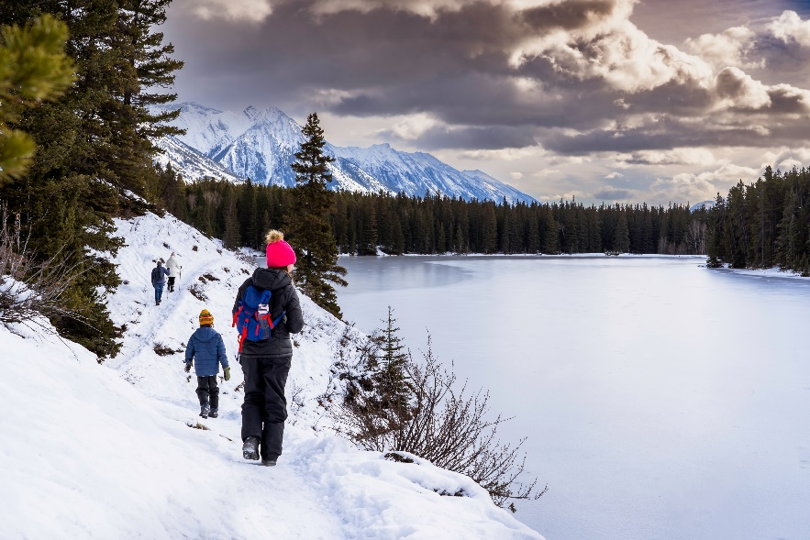

Activity 3 Stay Together, Stay Close
If you are going on your own near water, what could you do to keep safe?
Planning for a day out can help you keep safe: what could you bring with you?
Why is it important to look out for others when near water?
Notes:
Note: Please issue a safety warning before playing this video.
Note: This video will be replaced with a Scottish version, currently being created with Scottish Tech Army.
Read the questions before playing the video. Let pupils know that although this is not a true story, it is sadly based on tragedies that have occurred across Scotland.

Slide 8
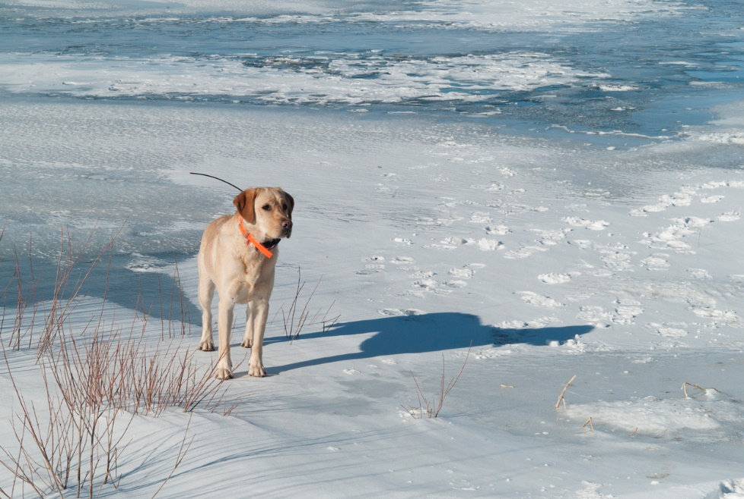
Activity 4 Stay Together, Stay Close
What should you avoid doing with your dog near water?
What could you do to keep your dog safe near water?
What should you do if your dog is stuck on the ice?

Slide 9
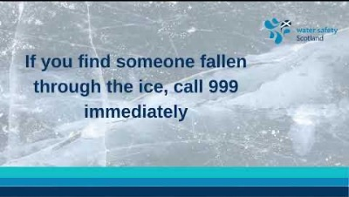
Activity 5
Why should you never go into the water to help someone?​
What would you do if someone encouraged you to walk on frozen water?
Notes:
Activity 4
Youwill need the following:
Bucket or bowl
Cold water (with ice cubes if available)
Paper towels, or towel, to dry hands
Pen and paper
Timer
Ask for two volunteers. Ask them to each write their name on a piece of paper. Then, get them to place one of their hands (the one they write with) into the water. Ask the class how long they estimate they can keep their hands in for. And ask the volunteers how long they estimate they can keep their hands in for. (Start a timer.)
Ask the volunteers how it feels, what sensations they are feeling.
Then, ask them how they’d feel if their whole body was in the water. What emotions might you feel? Would you feel scared, disorientated?
Ask them what they would do in that scenario.
The same volunteers then need to write their names on a piece of paper and explain if it felt different. Was it difficult to do? Were their hands shaking? Why might that be?
Note: If they fell into water, they should:
Try not to panic
Not attempt to remove clothing
Not attempt to to swim. Instead, they should float on their back for 60 seconds. This will allow them to calm down, get used to the temperature of the water and think about what to do next (swim or shout for help).

Slide 10
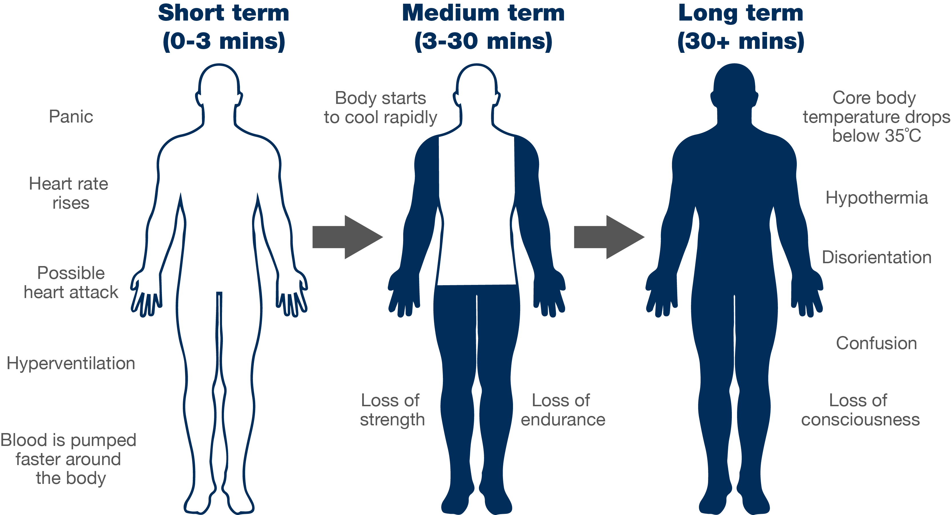
Cold water shock
Notes:
This slide demonstrates how cold water shock affects your body at various stages.
Challenge questions
Is anyone surprised by this order?
What would you do to calm yourself down?
How could calming down increase your chance of survival?
How could floating save your life?
Anything below 15°C is defined as cold water and can seriously affect your breathing and movement, so the risk is significant most of the year.
The average temperature of the sea around the UK and Ireland is about 12°C.

Slide 11
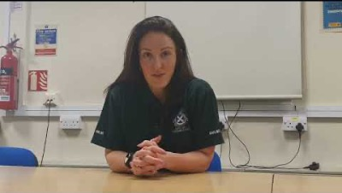




What should you do if you get into trouble in the water?
Important advice from Gemma Lightbody,
Scottish Ambulance Service
How would you react?
What emotions might you feel?
How would your body feel?
Key points:
Call 999 if you have a mobile on you
Instead of panicking, Float on your back
After you have calmed down shout loudly for help
If you can – attempt to swim to shore or find something that floats
Notes:
What is the typical temperature of a swimming pool? 29°C and that still feels chilly when you first enter
The water around our coasts or in rivers rarely gets above 15°C, so cold water shock is always likely
Ask the pupils : How could floating have helped the boy in the previous video?
Float to Live
Instead of panicking and trying to swim, float on your back for 60 seconds. If there’s space, ask the pupils to simulate ‘floating’ on their backs on the floor. Act like a ‘starfish’ – legs and arms out, moving arms in the water slowly. This will help calm you down, get your body used to the temperature of the water and give you time to think. After 60 seconds, either try to swim to something (shore, something that floats), or shout for help (count down from three and ask pupils to put one hand in the air, waving, and shouting ‘help’ loudly).
Encourage pupils to use their local pool to practice floating.

Slide 12
Activity 6
Have you learned the Water Safety Code?
Think of that same body of water again.
Not all dangers are visible: think of two that you can’t always see.
What two actions should you take if you see someone in trouble in the water?
What should you do if you find yourself in water unexpectedly?
How would you challenge dangerous behaviour you see?

Slide 13
Notes:
To gauge understanding, ask pupils:
Why should you never attempt to enter the water to help someone?
Who do you call in an emergency?
Who do you ask for when at the beach? At a loch?
Which three things can you do to stay safe near water?
Why can some dangers be hidden?
If you fall into cold water, what should you do?
Which three pieces of advice would you give someone about water safety? Should these bullets be in the PowerPoint slide, in the Notes?

Slide 14


