Slide 1
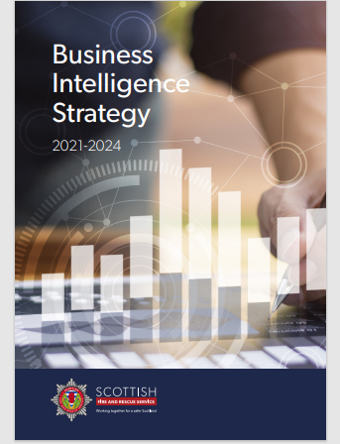
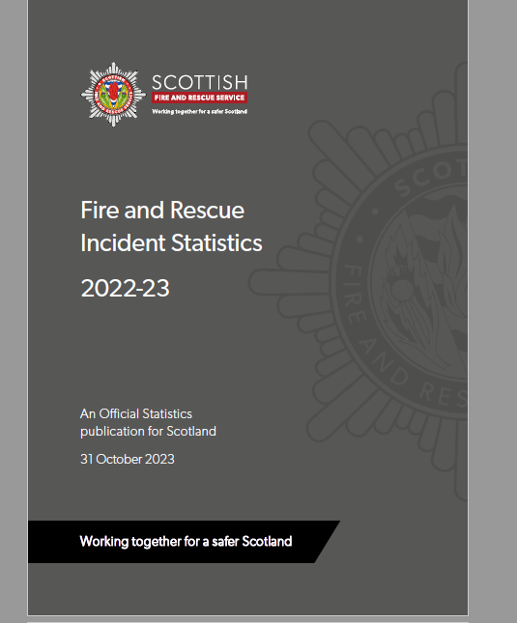
Scottish Fire and Rescue Service
Fire Related Injuries and Activity Data
Notes:
Scottish Fire & Rescue Service has a Business Intelligence Team which brings SFRS data to life, making sense of the wide range of information that is available to provide high quality intelligence and insightful analysis for our personnel, partner agencies and members of the public. A Business Intelligence Strategy 2021-2024 sets out a vision for SFRS to develop the use of data, analysis and insights to bring about improvements across the Service and its ambition is that we will become an exemplar of Business Intelligence for Fire and Rescue Services by 2025. In practice this will mean a clearer understanding of performance in all areas of the service.

Slide 2
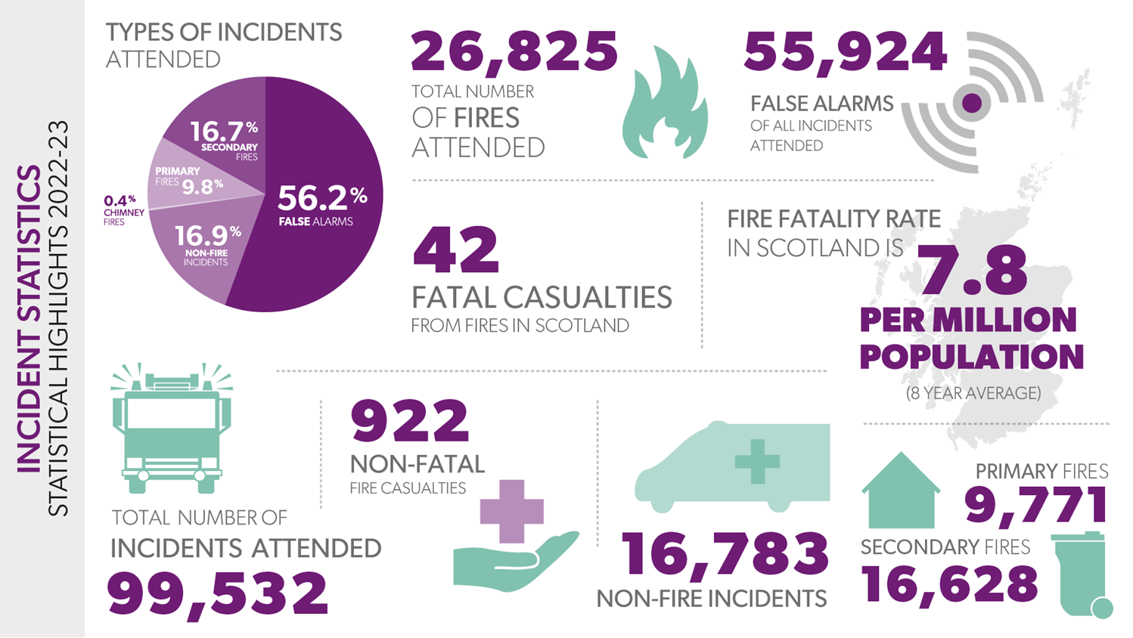
Notes:
Summary of some statistics. The following slides will provide some more in-depth data recorded. Our preventative work is based on a review of this data.
SFRS attended nearly 100,000 incidents
One quarter of which were fires
10’000 were primary fires
Just over 16’000 secondary fires
17’000 non fire incidents
Within these incidents there were 922 non-fatal fire casualties.
The fire fatality rate in Scotland is 7.8 per million population

Slide 3
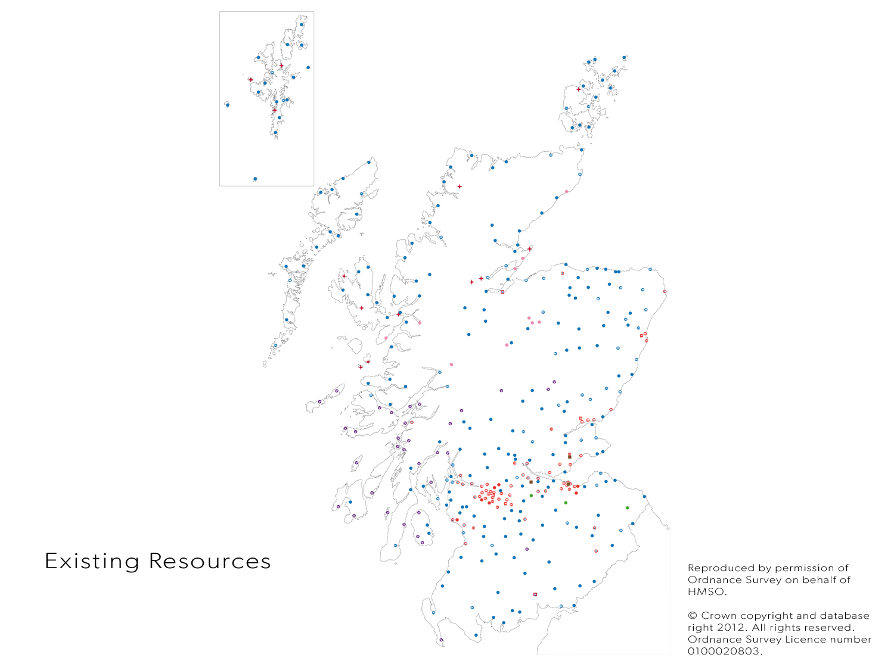
Scottish FRS
Resources
● Wholetime Stations (74)
● On Call Stations (240 RDS
42 Volunteer)
Notes:
P&P activities and initiatives are carried out at by a range of personnel qualified in various aspects of Community Safety Engagement (CSE), Fire Safety Enforcement (FSE), Fire Engineering (FEng) and Fire Investigation (FI).
CSE activities are carried out by all operational personnel as part of their role map.
On call (formerly known as RDVS) Watch Commanders often support P&P priorities in their local area
CSE activities are enhanced and supported by the local CAT who are embedded within each LSO Area and comprise of uniformed and non uniformed members of staff.

Slide 4
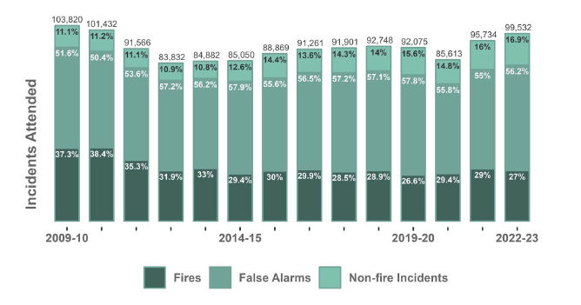
Summary of SFRS Statistics 2009 – 2010 to 2022-23
Notes:
These stats show that fires were plateauing at around 29%. 2020/21 we see a dip due to lockdown and a reduction in secondary fires. SFRS expect to see a significant drop in non-fire incidents with SFRS’s new UFAS policy.
All Incidents
In 2022-23, SFRS attended a total of
99,532 incidents, 4% increase in previous year.
There were 4,895 fires per million population in Scotland.
Dwelling fires have steadily decreased in England, Wales and Scotland.
Scotland has had a consistently higher rate per million population than the other nations.
In 2022-23 there were 786 dwelling fires per million population.
Deprivation and urban rural profile of communities influences fire rates at a national level which could explain why there are differing rates between nations.

Slide 5
Notes:
2022-23 Trends in Fires
26,825 fires attended, down 3.5% on previous year
4,305 dwelling fires, down 7.1% of which:
3,873 of these were accidental, down 7.7%
58.8% of accidental dwelling fires started with a cooking appliance
72.2% of dwelling fires were confined to the original item ignited
1,984 vehicle fires, down 0.8%
18,217 outdoor fires (excluding road vehicles) down, 3.5%

Slide 6
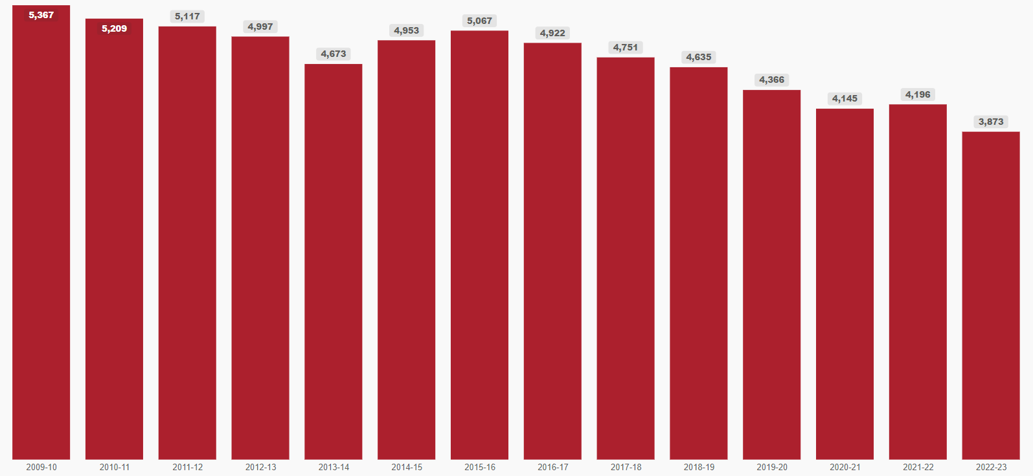

Accidental Dwelling Fires 2009 – 2023
Notes:
2009 / 10 - 5,367
2022 / 23 - 3,873

Slide 7
Notes:
Non- Fatal Casualties in Fires
There were 922 non-fatal fire casualties in 2022-23 up from 804 previous year (14.7% increase).
This figure shows the historical overall decreasing trend in non-fatal casualties in fires since the early 2000s.
In 2022-23, 835 (90.6%) of these casualties were in dwellings,
51 (5.5%) were in other buildings
20 (2.2%) were in road vehicles

Slide 8
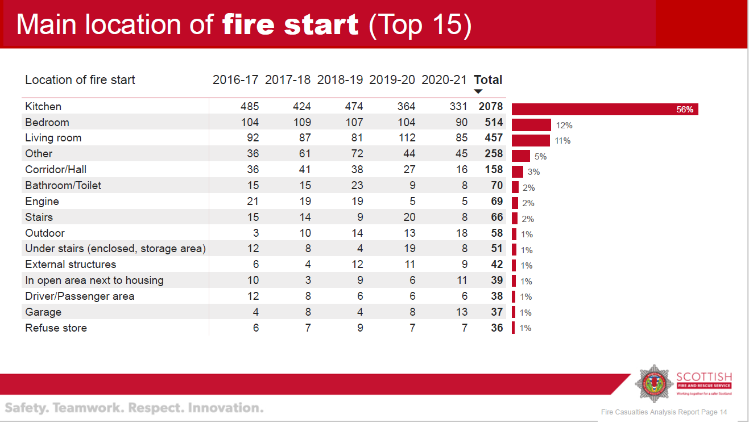
Notes:
What causes fire casualties and fire fatalities in 2022-23
Ignition source - The main source of ignition in accidental dwelling fires was cooking appliances
Impairment – 14.7% Accidental Dwelling Fires had impairment through alcohol and drugs
Spread of Fire – 39.3% caused smoke or heat damage only and 1,415 (32.9%) were confined to the original item ignited. However, 361 (8.4%) fires spread beyond the initial room that the fire started in
Smoke Alarms – were absent from 26.1% dwelling fires in 2022-23. This has reduced by 30.9% from 2012-13.

Slide 9
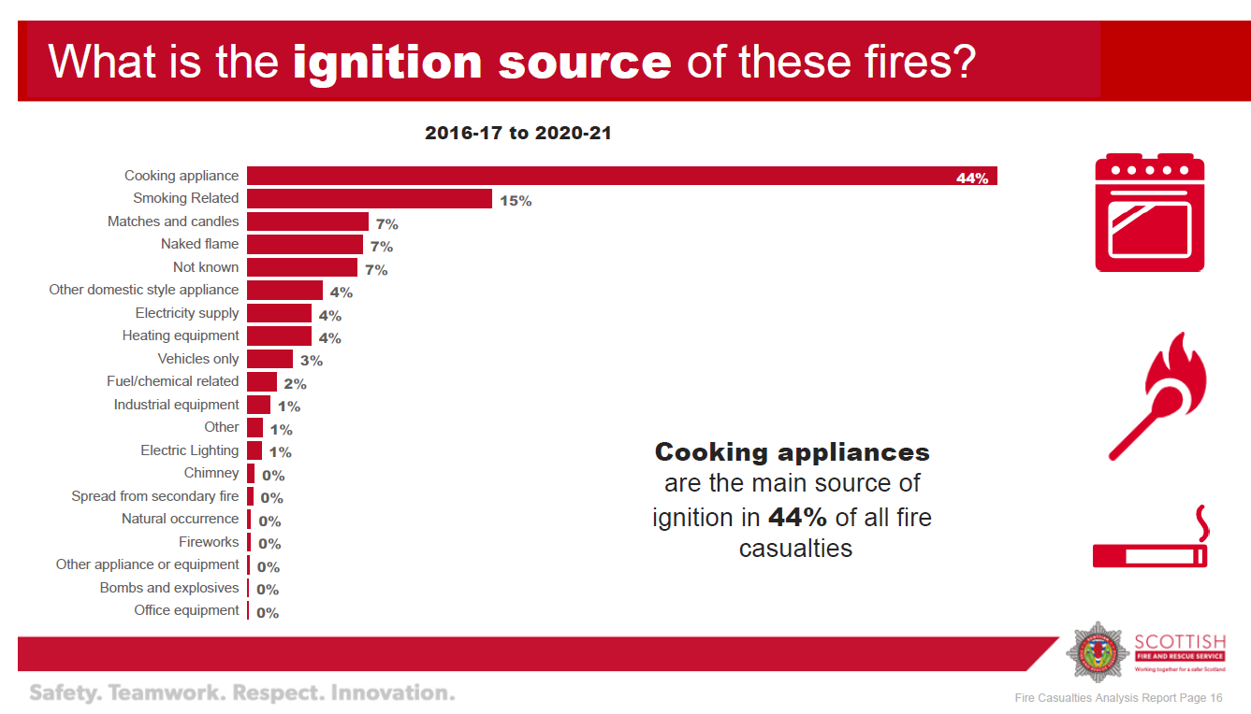

Slide 10
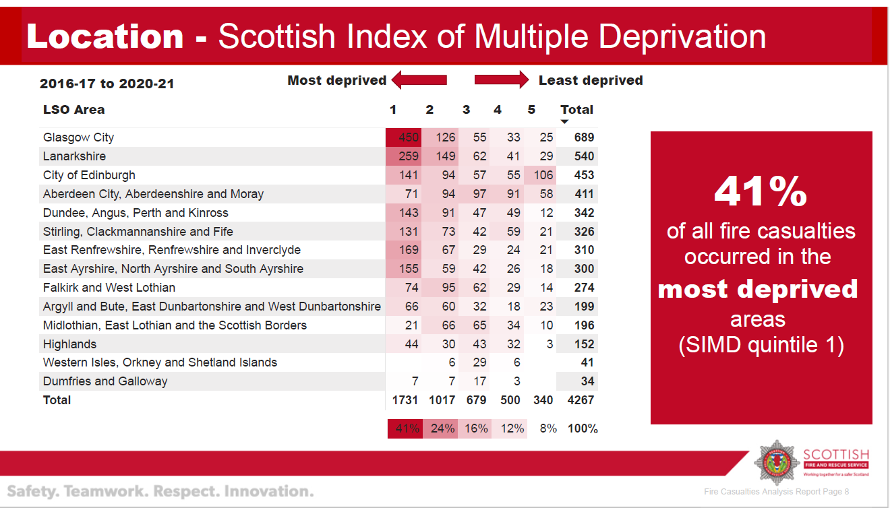

Slide 11
Fatal Casualties Attended
Notes:
Fire Casualties Attended – information on non fire and other causes in next slide
There were 449 fatal casualties in 2022-23 up from 420 last year.
Non - Fire - 398
Fire – Other Cause 9
Fire – Caused by Fire - 42

Slide 12
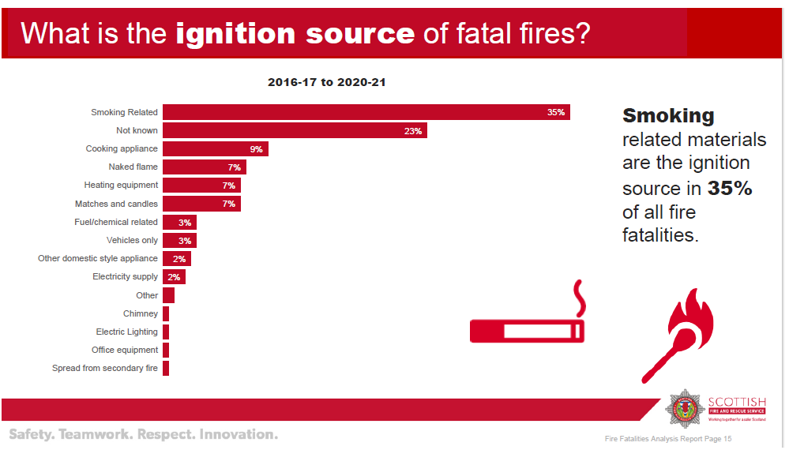

Slide 13
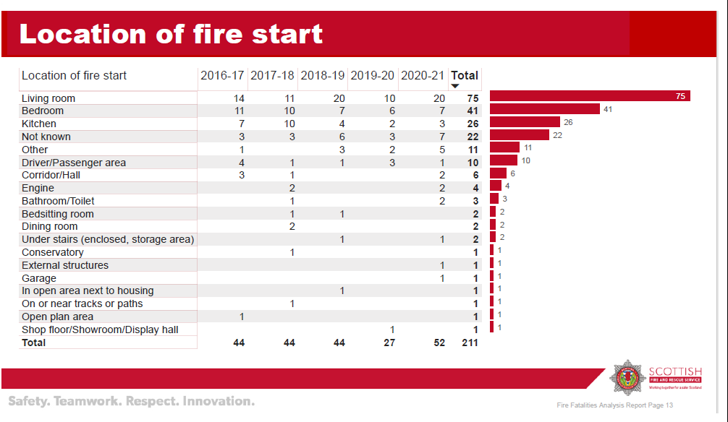

Slide 14
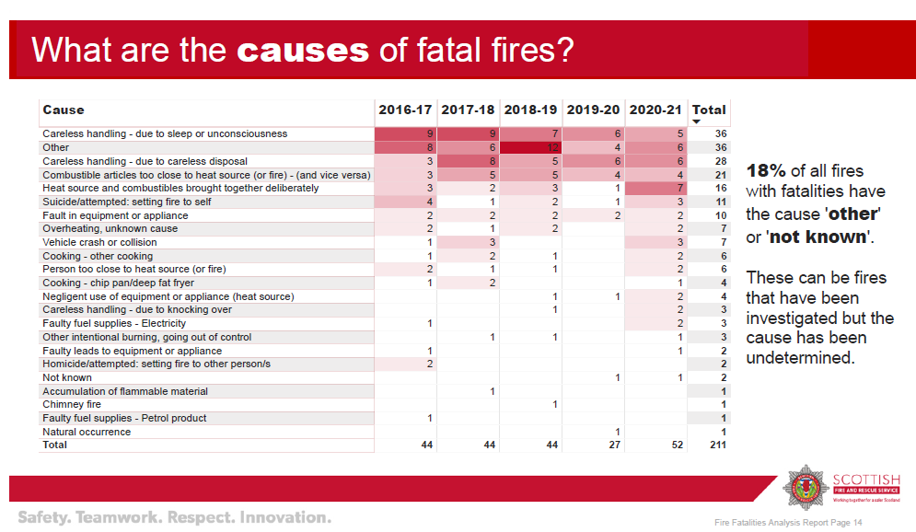

Slide 15
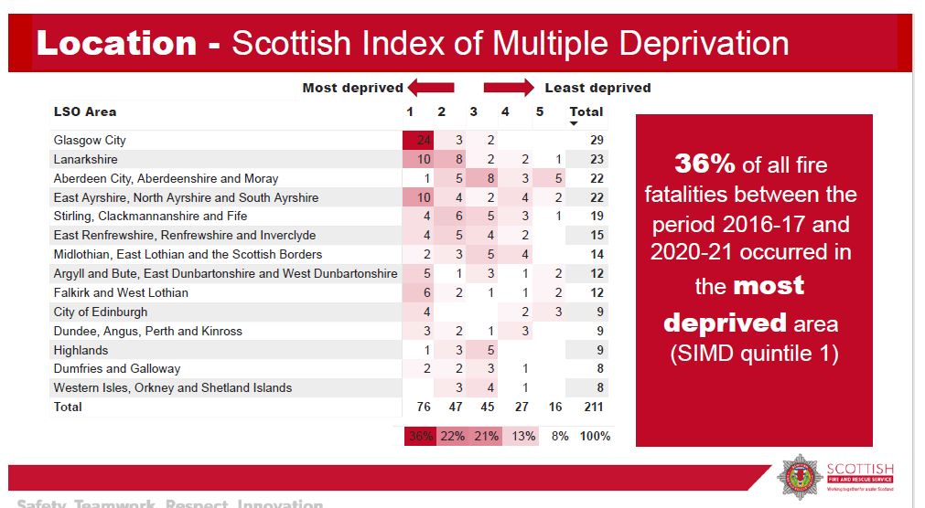
Notes:
Fatal Fire Casualties
In 2022-23 Annual totals have varied considerably in the past. The 10 year average for fatal fire casualties is 41. This graph shows an overall downward trend since 1990 with this figure levelling off since the early 2010s. Of the 42 fatalities, 32 were in dwellings (76.1%), 5 were in other buildings (12.0%) and 3 were in road vehicles (7.1%). Data also shows that the majority of fires occur in the winter months, i.e.
42 fatal fire casualties (up from 40 last year),
32 (76.1%) of these occurred in dwelling fire (up from31 from last year)
5 were in other buildings
3 were in road vehicles
54.8% of fatal fire casualties were male
4.7% times higher rate of casualties in the most deprived areas over the last 8 years

Slide 16
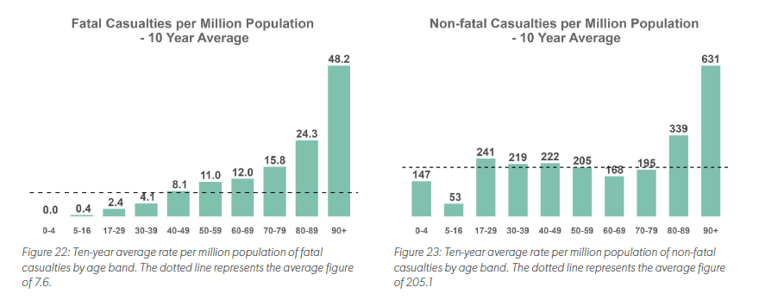
AGE (2013 – 2023)
Notes:
Relationship between Age and Non-Fatal Casualties - Ten-year averages have been used to give a robust comparison as one year figures can vary a lot
The relationship between age and non-fatal casualties is not as strong as it is for fatal. In contrast to fatal, those aged 60-79 have a rate below average. However, similar to fatal casualties, those aged 80-89 and over 90 have a rate above average
Those aged below 39 have a rate of fatal casualties below average,
Those aged 0-4 years having a rate of 0.0.
Those aged 80 and over have a rate considerably higher than other age categories
Those aged 80-89 having a rate 3.2 times the Scotland average
Those aged 90 and over having a ate 6.3 times higher than the Scotland average.
We have recently produced an Ageing Safely Framework document which highlights a number of key components of fire risk for older people and sets out a number of key objectives on how we can address these – aligning with the work that is ongoing with a new HFSV process targeting the most vulnerable in society.
Gender
Non-fatal casualties with males have a rate of 187.8 casualties per million population in 2022-23 and females have a rate of 132.2 casualties.
23 (54.8%) Male
18 (42.9%) Female

Slide 17
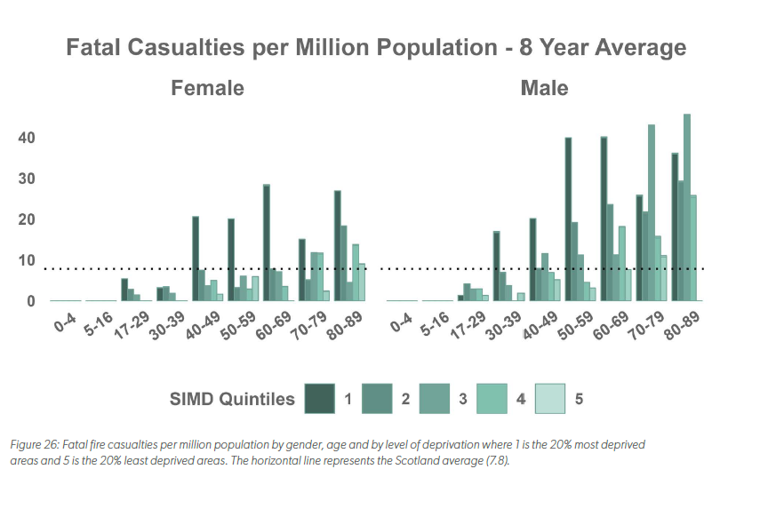
2015 - 2023
Notes:
Fatal Fires per million population – 8 year average – from 2015-2023
The diagram shows that for fatal casualties, there is a clear link between deprivation and fatal casualty rate.
Except for males aged 17-19, and 70 or over, those in the most deprived areas have a higher rate of fatal casualties per million population.

Slide 18
Non-Fire Incidents 2022 / 23
16,783 non-fire incidents – up from 15,294 in previous year
83.1% increase in non-fire incidents in last 10 years
  Assist other Agencies
  Road Traffic collisions
  Flooding incidents
Notes:
There were 3,139 flooding incidents attended in 2022-23, compared to 1,617 last year (94.1% increase). This is the largest figure for flooding incidents since this series began and is likely due to weather conditions experienced in winter 2022.

Slide 19
Non-Fire Casualties 2022/23
2,481 non-fatal casualties
398 fatal casualties
140 were at effecting entry/exit incidents
Notes:
Non-Fire Casualties
398 fatal casualties, up 7.0% of which, 85 were at road traffic collisions
140 were at effecting entry/exit incidents
2,481 non-fatal casualties, up 2.9%
Fatal casualties at assist other agencies incidents increased from 58 to 65 12.1% increase

Slide 20
Casualties from non-fire incidents
2022 - 23
Type of non-fire incident | 2022-23
Road traffic collision | 85
Other transport incident | 5
Flooding | 0
Rescue or evacuation from water | 24
Other rescue or release of persons | 13
Evacuation (no fire) | 1
Lift response | 0
Medical incident – Co responder or first aid | 23
Suicide and suicide attempt | 30
Hazardous materials incident | 5
Spills and leaks (not RTC) | 0
Removal of objects from people | 0
Animal assistance incidents | 0
Effecting Entry Exit | 140
Making safe (not RTC) | 2
No action (not false alarm) | 5
Water provisions | 0
Stand by | 0
Assist other agencies | 65
Advice only | 0
Total | 398

Slide 21
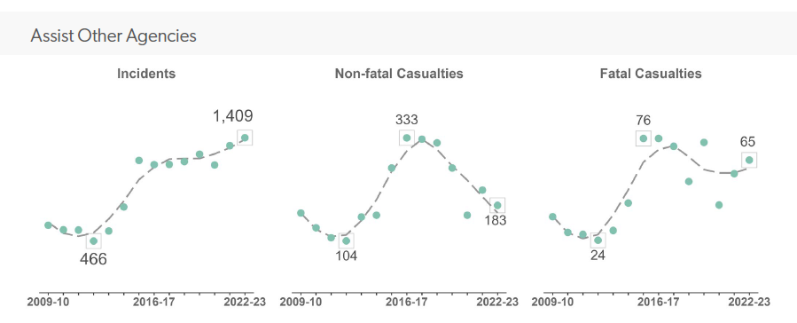
Notes:
Assisting other agencies
Assisting other agencies has risen over the past 10 years.
These types of incidents will include incidents like,
Making vehicles safe
Ship Sinking
Suicide attempt
Bomb suspected or confirmed
UK FRS Search and Rescue Team requested to be sent abroad
This list has been taken from SFRS Incident Reporting System

Slide 22
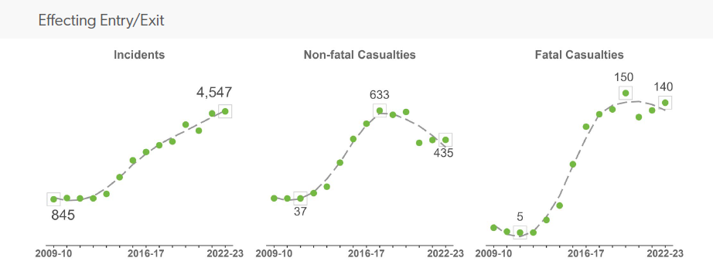
Notes:
Effecting entry/exit 2022-23
This includes assisting SAS to gain access to properties
Incidents – 4,547
Non-Fatal Casualties - 435
Fatal Casualties - 140

Slide 23
Future Considerations
Ageing population
Climate Change
  Flooding incidents make up a large proportion of incidents attended – 94.1% increase
  Wildfires – 5,937 Grassland fires in 2022-23
  Winter Warmth
Notes:
Climate Change
Scotland has vast access to water with over 30,000 lochs, 18,000 kms of coastline, over 200 rivers and a vast canal network, not to mention local streams and burns etc. Many of these are in remote locations. With warmer summers and hotter weather, public don’t always understand risk or know how to respond safely in an emergency.
Flooding incidents make up a large proportion of incidents attended – 94.1% increase
Wildfires
Water Incidents
96 people per year on average drown in Scotland
50% of drownings were accidental
60% occurred inland
Males aged 50-59 were highest age group of accidental drownings
Source: RoSPA Annual Trend Report 2022

Slide 24
Cathy Barlow, (Deputy Head of Prevention, Protection & Preparedness )
Scottish Fire and Rescue Service
Cathy.barlow@firescotland.gov.uk

