Slide 1
Road Safety data and Scotland’s
Road Safety Framework to 2030
Dr Karen McDonnell, OSH Policy Adviser RoSPA
Chair of the Scottish Occupational Road Safety Alliance.

Slide 2
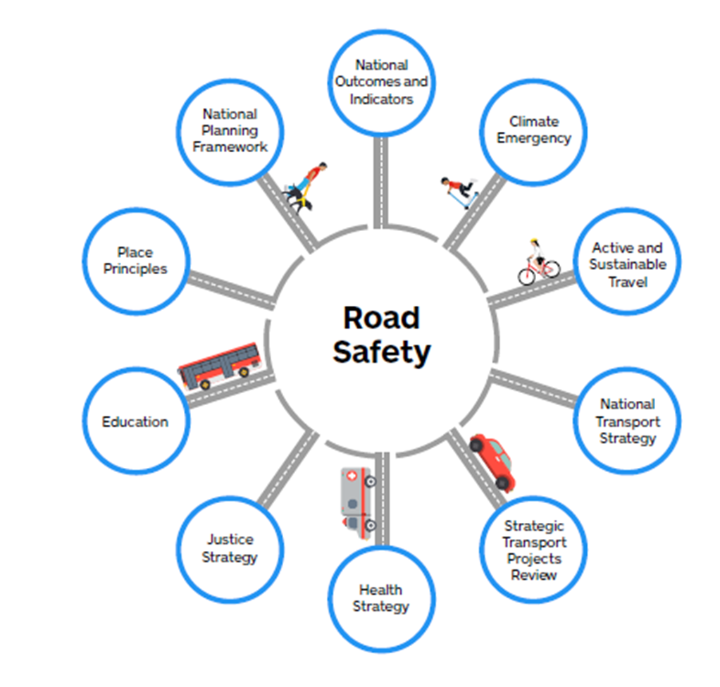
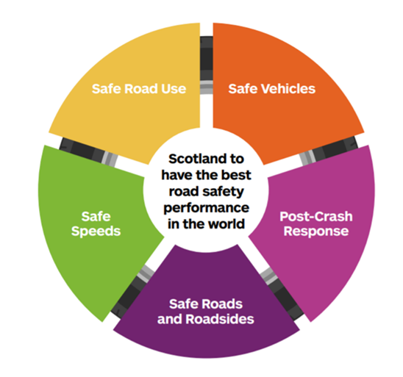
Road Safety Framework to 2030

Slide 3
Road Safety Framework to 2030

Slide 4
Road Safety Framework to 2030
Key Priority Groups
Age, Motorcycles, VRU’s and Driver Behaviour & Enforcement

Slide 5
Speed Limits
Fatalities
All casualties
 | 2019 | 2020 | 2021 | 2022 | Total
20 | 4 | 6 | 7 | 7 | 24
30 | 37 | 39 | 33 | 31 | 140
40 | 12 | 9 | 4 | 7 | 32
50 | 6 | 9 | 6 | 12 | 33
60 | 85 | 67 | 74 | 101 | 327
70 | 20 | 11 | 17 | 15 | 43
Total | 164 | 141 | 141 | 173 | 455
 | 2019 | 2020 | 2021 | 2022 | Total
5 | 0 | 0 | 0 | 2 | 2
15 | 2 | 0 | 1 | 0 | 3
20 | 612 | 418 | 587 | 602 | 2219
30 | 3387 | 2297 | 1969 | 2201 | 9854
40 | 504 | 345 | 336 | 399 | 1584
50 | 323 | 185 | 248 | 252 | 1008
60 | 2297 | 1506 | 1523 | 1685 | 7011
70 | 581 | 311 | 451 | 480 | 1823
Total | 7706 | 5062 | 5115 | 5621 | 23504
60 mph is the most frequent speed limit
at which fatalities happen,
Also the biggest increase from 2021
30 mph is the most frequent speed limit at which all casualties happen

Slide 6
Where do collisions happen?
Highlands have the highest number of fatalities (32)
Most collisions happen in B,C and unclassified roads but most fatal collisions happen in A roads (68%)
Pedestrians: central belt

Slide 7
Target 1: Reduce fatalities by 50%
Reduction achieved in 2022:
0%
↑33 fatalities from 2021 (23% increase)
Highest since 2016
Identical to 2014-2018 average

Slide 8
Age of fatalities
 | less than 20 | 20-29 | 30-39 | 40-49 | 50-59 | 60-69 | more than 70 | Total
Fatalities in 2022 | 8 | 25 | 27 | 19 | 23 | 24 | 47 | 173
Fatalities per million population* | 7 | 36 | 36 | 28 | 29 | 36 | 61 | 32
70+ age group has the most fatalities
70+ age group is twice as likely to be in a fatal accident than Scotland’s average person
Highest increase between 2021 and 2022 was in 30-39 group

Slide 9
Reported Road Casualties Scotland 2022
Unwelcomed rise in casualties with the number those killed in road collisions being the highest since 2016.
2021 recorded the lowest number of road fatalities since records began (140).
173 fatalities during 2022, a 23% increase from the previous year.
The scale of increase in fatalities is high when compared against England (increase of 9%) and Wales (increase of 10%). Had we remained on track to meet the 2030 target of a 50% reduction in fatalities, the total road death figure should have been closer to 129, not 173.

Slide 10
What role can you and your organisation play?
Own it
Understand it
Control it
Think holistically

Slide 11
www.scorsa.org.uk
info@scorsa.org.uk
Any Questions?

