Slide 1
Safety made simple
Katrina Phillips, Chief Executive
Child Accident Prevention Trust

Slide 2

Our vision
All children lead active, healthy lives,
safe from the disabling effects
of serious accidental injury

Slide 3
Making a difference by:
Empowering families
Supporting professionals
Influencing for change
Tackling inequalities
Partnerships

Slide 4
Why Child Safety Week?
Statistics are people with the tears wiped away
14
1 in 18
5,919
1 in 7

Slide 5
Disadvantage
1 in 4 children in Scotland (24%) living in relative poverty after housing costs Scottish Govt
“Children under five living in disadvantaged households in Scotland are more likely to suffer severe and multiple injuries in their homes than children from better-off families” Glasgow University

Slide 6

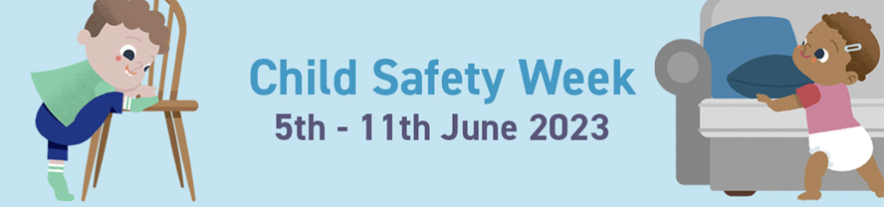
Child Safety Week 5-11 June
Free resources to use and share
Parents pack
Fact sheets & activity sheets
Session plans
Poster
Social media pack

Slide 7

Dog safety
Advice developed in partnership with Dogs Trust, RSPCA and DEFRA https://capt.org.uk/dogs-and-children/
New fact sheets x 2 – Safety around dogs plus Your dog and your new baby

Slide 8
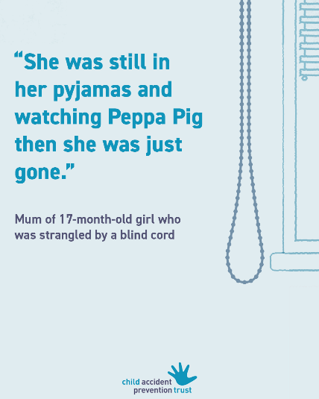
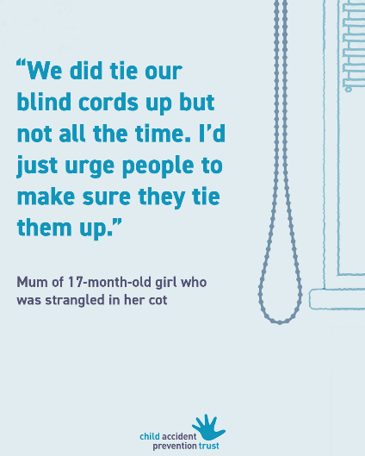
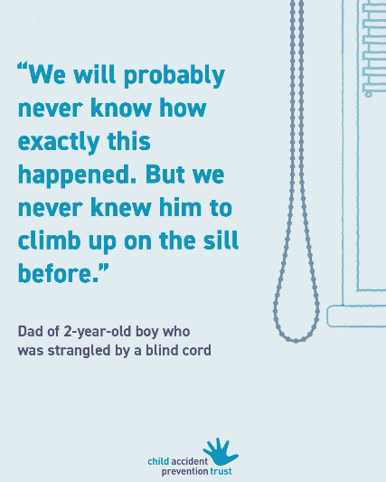
Blind cords
Advice hub https://capt.org.uk/blind-cords/
Free fact sheet and session plan

Slide 9

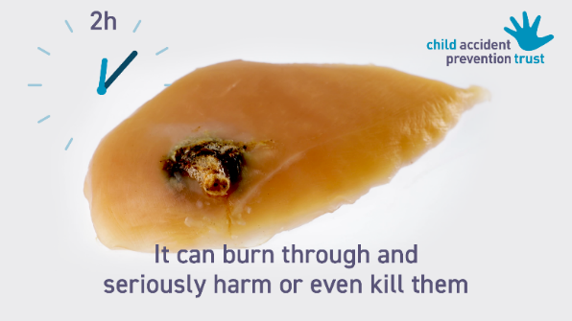

Button batteries
Order free printed resources

Slide 10
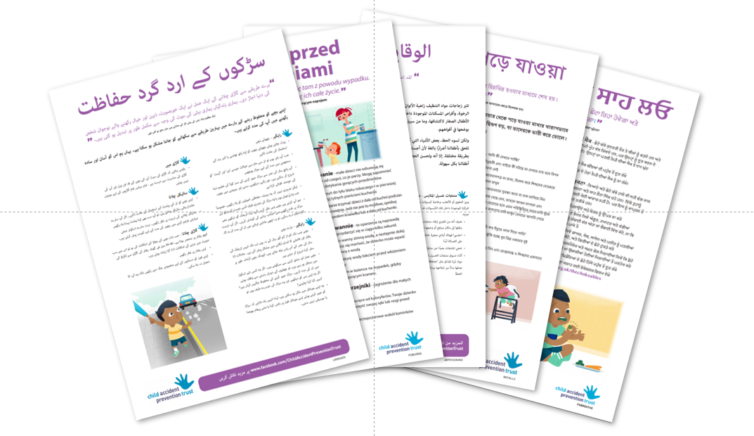
Advice in translation

Slide 11



Social media
Videos, quizzes, links to free downloads

Slide 12
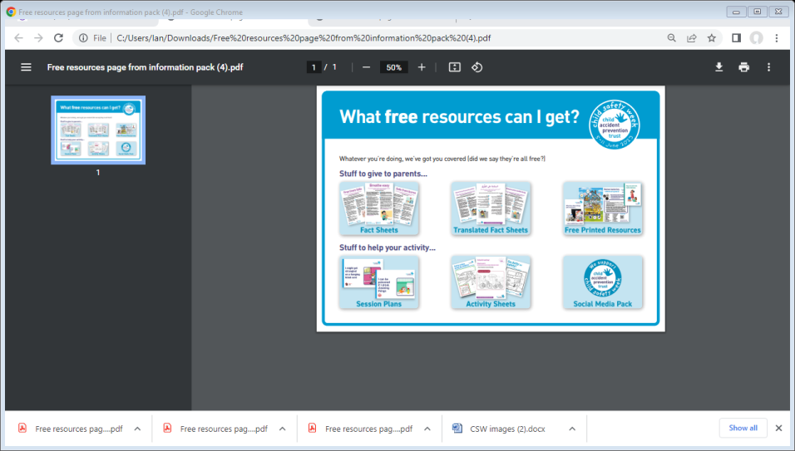
New resource centre
ALL our free educational resources
Searchable by topic and type of resource
Visit https://capt.org.uk/resource-centre

Slide 13
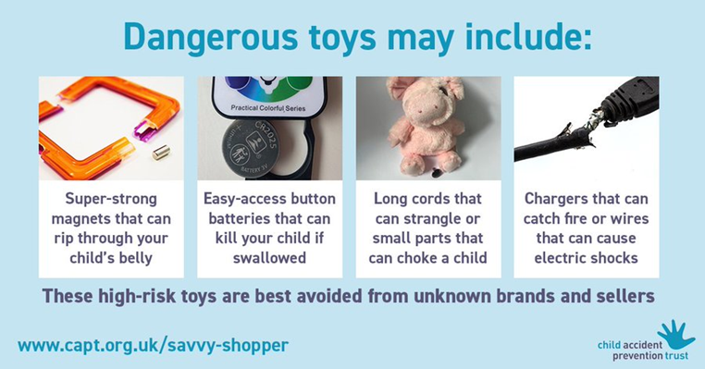
Advice hubs
Hubs with advice on:
Button batteries
Super strong magnets
Blind cords
Choking
Shopping online
Buying safe toys
Fireworks
Visit www.capt.org.uk

Slide 14
“If I can buy it, it must be safe”
More than half of parents (54%) mistakenly believe that all sellers on online platforms are checking the safety of their products.
Almost three-quarters of parents (74%) wrongly believe that any product aimed at children under 5 has to be fully tested and certified safe by an independent body before it can be sold online.

Slide 15
Stay in touch
Join our subscribers across Scotland https://www.capt.org.uk/sign-up
Facebook https://www.facebook.com/ChildAccidentPreventionTrust/
Instagram https://www.instagram.com/capt_charity/
Twitter https://twitter.com/captcharity
Website www.capt.org.uk

