Slide 1

the heart of
health and safety
Notes:
This is the logo slide. Please do not alter.

Slide 2
Occupational cancer and IOSH’s No Time to Lose campaign
Dr Karen McDonnell, CFIOSH, Chartered FCIPD
IOSH President Elect, Head of RoSPA Scotland

Slide 3
Recent research
Dr Lesley Rushton: ‘The burden of occupational cancer in Great Britain’
First study of its kind confirming the connection between what people do for a living, and the cancers they develop
Takes into account lifestyle choices such as smoking
Occupational attributable cancer deaths and registrations = 5 per cent of all UK cancer deaths and registrations
Notes:
Recent research
This figure comes from the Rushton Report of 2012 – a breakthrough research study
The only national study of this kind, but of course numerous other studies across the world on individual carcinogenic exposures such as solar radiation or mineral oils
Factors in lifestyle choices to get a true picture
The researchers found that work-caused cancer is the fifth biggest cause of avoidable cancer, behind lifestyle choices like smoking or diet

Slide 4

The findings
8,000 work-related cancer deaths a year
Almost 14,000 new cancer registrations each year are down to occupational exposure
Just under half of deaths put down to occupational cancer are in the construction industry
Notes:
The findings
Let’s look at what the research found…
8,000 deaths a year caused by exposure to carcinogens in the workplace
Almost 14,000 new cases of cancer caused by work are registered each year in the UK
4,000 because of asbestos exposure – but 10,000 other cases are linked to exposures ranging from silica dust to diesel engine fumes
It’s not just construction, but there’s no getting away from the fact that a lot of the sector’s activities are implicated in these exposures

Slide 5
Top 10 causes of cancer deaths attributable to occupational carcinogens (Rushton/HSE)
Rank | Agent/activity | Number of deaths/year
1 | Asbestos | 3909
2 | Silica | 789
3 | Diesel engine exhaust | 652
4 | Mineral oils | 566
5 | Shiftwork | 552
6 | Painters | 334
7 | Tobacco smoke | 249
8 | Tertachlorodibenzodioxin | 231
9 | Radon | 184
10 | Welders | 152
Notes:
Top 10 causes of cancer deaths
This shows you the breakdown of carcinogens linked to cancer deaths

Slide 6
Top 10 causes of cancer registrations attributable to occupational carcinogens (Rushton/HSE)
Rank | Agent/activity | Number of Registrations/year
1 | Asbestos | 4216
2 | Shiftwork | 1957
3 | Mineral oils | 1730
4 | Solar radiation | 1541
5 | Silica | 907
6 | Diesel engine exhaust | 801
7 | Coal tars and pitches | 545
8 | Painters | 359
9 | Tertachlorodibenzodioxin | 316
10 | Tobacco | 284
Notes:
Top 10 causes of cancer registrations
looking at registrations changes the order as some are more detectable and treatable eg non malignant skin cancer
remember that these figures are all for the UK – across the world, it’s estimated that 666,000 people die every year from a work-related cancer – that’s one death every 47 seconds

Slide 7
No Time to Lose: campaign on occupational cancer
raise awareness of a significant health issue facing workers in the UK and internationally
suggest some solutions on a UK scale to tackle the problem – a national model that can be transposed internationally
offer free practical, original materials to businesses to help them deliver effective prevention programmes
Notes:
No Time to Lose: campaign on occupational cancer
The main point of the campaign is to raise awareness. Work-based carcinogens are largely under the radar and we need to raise their profile if we want to see more action to control them.
We’ve created a nine-point call to action, pressing the government, the regulator and others to do more to address the issue, eg to maintain a comprehensive national occupational carcinogen exposure database and to fund more research into occupational cancers, including on managing risks from new developments. Details are in ‘A time for action’ – like all our materials, you’ll find it on the campaign website
Responsible businesses are doing a lot of what is required, but they need to do more. We’re developing resources to help

Slide 8
The campaign
50+ work-related carcinogens – focusing on a ‘top five’:
  Asbestos
  Diesel engine exhaust
  Shiftwork
  Silica
  Solar radiation
Free practical resources and tools
Notes:
The campaign
The IARC lists more than 50 substances as known or probable work-based carcinogens – we’ll be focusing on five of the more serious carcinogens, based on the numbers of UK registrations and deaths. We’re referring to UK data, as it’s the most complete national picture we have, but of course we find these carcinogenic exposure issues across the world.
Asbestos – affecting many areas, mostly construction and trades like plumbing or maintenance, but also in sectors like retail, education and public services, where older buildings will contain asbestos
HSE estimates 1.8 million people still at risk
Awareness of asbestos is of course much more widespread but there is so much still in situ. Lots of cases of exposure, and one astonishing recent case where a Shropshire director was jailed for illegally supplying asbestos sheeting after a worker fell to his death.
Diesel – again, affects many areas, not just transport, but construction trades, energy extraction, warehousing, agriculture, mechanics
HSE estimates 10,000 at risk, but others put figure far higher
Deaths are estimated at 650 a year to lung or bladder cancer
Shiftwork – largely an issue for women, unlike other male-dominated areas.
More research is needed, but it’s estimated that shiftwork causes 2,000 cases of breast cancer a year
Silica – roofworkers, stonecutters, construction workers, roadworkers
Deaths estimated to be 800 a year
Rushton’s modelling showed that if compliance with current controls of RCS could be improved from 33% to 90%, over 600 cancer registrations would be avoided
Solar radiation – a number of trades affected, from construction through roadworkers to farmworkers.
This is more treatable than some cancers, but the registrations are still high and there have been deaths attributed to excessive sun exposure at work
We’ll be producing materials across the life of the campaign – all free. The first pack is on diesel engine exhaust emissions – already available to download from the campaign website. Next pack will be on solar radiation (April 2015)

Slide 9










Getting involved – formal support
Endorse the campaign with a statement and your logo
Receive a supporter pack
Spread the word within your company and supply chain
Join more than 60 organisations and companies …
Notes:
Getting involved – formal support
We’d really welcome your formal endorsement of the campaign. It’s simply a matter of agreeing a few sentences to reflect your support or your commitment to taking action on the issue – and letting us have your logo to add to the website
You’ll get a supporter pack, including a supporter logo, as well as updates on new campaign resources
We’ll ask you to share campaign messages, both in-house and through your supply chain if that’s relevant. All our supporters have offered to spread the word via their usual communication channels

Slide 10















Getting involved – pledge to take action
Pledge to take action on carcinogenic exposures using our six-point action plan
Receive a certificate
Get recognition as a responsible business showing leadership on this issue
Join these forward-thinking companies …
Notes:
Getting involved – pledge to take action
We’ve also developed a pledge – a practical action plan that you can customise to suit your business. Again, we’d encourage you to sign up to this – we know that if enough responsible businesses join our pledge group, then others will follow
You’re eligible to receive a certificate reflecting your pledge commitment – you can ask for an annual reminder to review your pledge too
You’ll get recognition on the campaign website and in our campaign communications
We launched the pledge with a group of ‘founder signatories’ …

Slide 11
A Time for Action
Government Action
Regulator Action
Joint Profession Action
Industry Action
Richard Jones , IOSH Head of Policy and Public Affairs
0116 257 3149

Slide 12
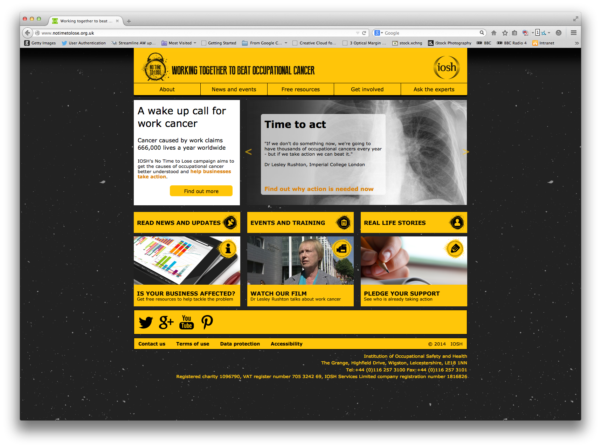
Campaign website
www.notimetolose.org.uk
access free information
download or order free practical resources
ask our expert panel for advice
find out about events and CPD opportunities
support the campaign
pledge your commitment to tackling harmful exposures at work
get the latest news on occupational cancer
read our national action plan
hear from people affected by work cancer
follow the campaign on Twitter @_NTTL
Notes:
Campaign website
Please visit the campaign website to find all the free resources, event details, catch up on campaign and occupational cancer news from around the world – or put a question to our expert panel

Slide 13
Thank you karen.mcdonnell@iosh.co.uk

