Slide 1

Young driver update
19 November 2015
Dr Sarah J Jones

Slide 2
Outline
Young drivers
The evidence
The policy context
Conclusions

Slide 3
The problem young Driver or
The young driver problem ?

Slide 4
Young drivers
2004, OECD Countries
  15 to 24 year olds
  27% of driver fatalities, 10% of popn
UK
  1 in 5 crash within 6 months of licence
  4 people killed or seriously injured each day in crashes involving young drivers
Often seen as a “boy racer” problem or problem of the minority

Slide 5
Casualty rates - licences

Slide 6
Casualty rates - population

Slide 7
Single vehicle crash casualties

Slide 8
Urban: rural

Slide 9
Years of life lost (80)
 | GB |  |  | Scotland
 | YD | OD | Ratio | YD | OD | Ratio
2000-02 | 62.1 | 39.9 | 1.55 | 61.3 | 41.5 | 1.48
2001-03 | 60.9 | 40.2 | 1.52 | 67.4 | 42.3 | 1.59
2002-04 | 61.4 | 40.5 | 1.52 | 63.9 | 39.5 | 1.62
2003-05 | 62.1 | 40.1 | 1.55 | 68.8 | 35.8 | 1.92
2004-06 | 62.9 | 40.2 | 1.56 | 65.0 | 34.5 | 1.88
2005-07 | 63.4 | 39.1 | 1.62 | 67.2 | 35.8 | 1.88
2006-08 | 64.1 | 38.7 | 1.66 | 65.2 | 37.8 | 1.72
2007-09 | 62.9 | 38.2 | 1.65 | 64.7 | 39.1 | 1.65
2008-10 | 61.1 | 38.1 | 1.60 | 61.0 | 39.9 | 1.53
2009-11 | 59.0 | 37.1 | 1.59 | 59.7 | 39.8 | 1.50
2010-12 | 58.4 | 36.9 | 1.58 | 57.4 | 39.1 | 1.47
2011-13 | 59.1 | 36.4 | 1.62 | 62.5 | 37.6 | 1.66
Notes:
Average YLL per fatal crash

Slide 10
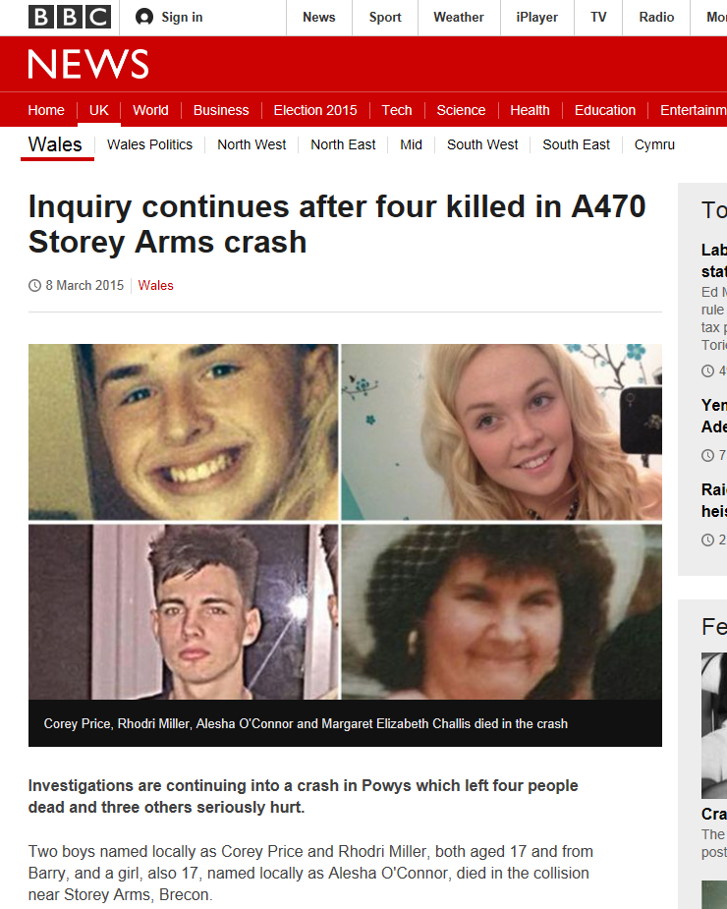
Not just about numbers...
Notes:
Not just numbers, not just deaths

Slide 11


Young driver risk factors
Age
  Exuberance, risk taking, peer pressure, sensation and thrill seeking
Inexperience
  Psychomotor skills, hazard perception, judgment, decision making
Joy riders
“the irresponsible minority
Young driver update
Notes:
YD are a product of who they are and the environment in which they exist, most YS are not deliberately unsafe, just inexperienced

Slide 12
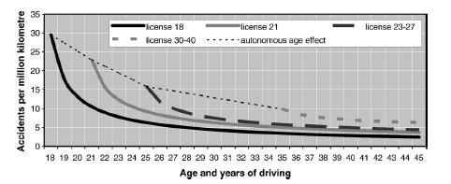

Slide 13
What can we do about it?
Legislation / Enforcement
Education
Pre-driver school based education
Driver training
Post-licence driver training
Raise licence age
Graduated Driver Licensing (GDL)

Slide 14
GDL?
Opportunity to gain experience under conditions of reduced risk
‘Intermediate phase’
  learner to full licence
‘Permission’ granted to drive unsupervised
  Permission not given for night time driving, carrying passengers, drinking any alcohol

Slide 15
The Evidence

Slide 16
Does it work?
4 to 60% decrease in casualties among newly qualified drivers
Ontario – 62% decrease in 12am to 5am crashes
California – 40% decrease in teen passenger deaths / injuries
Parents feel more ‘empowered’
Teens feel less ‘pressured’ into driving in situations that they are not comfortable with
Cochrane review – only positive effects

Slide 17
Does it work?
“GDL is effective in reducing crash rates among young drivers, although the magnitude of the effect varies. The conclusions are supported by consistent findings, temporal relationship, and plausibility of the association. Stronger GDL programmes (i.e. more restrictions or higher quality based on IIHS classification) appear to result in greater fatality reduction” (Russell et al., 2011).

Slide 18
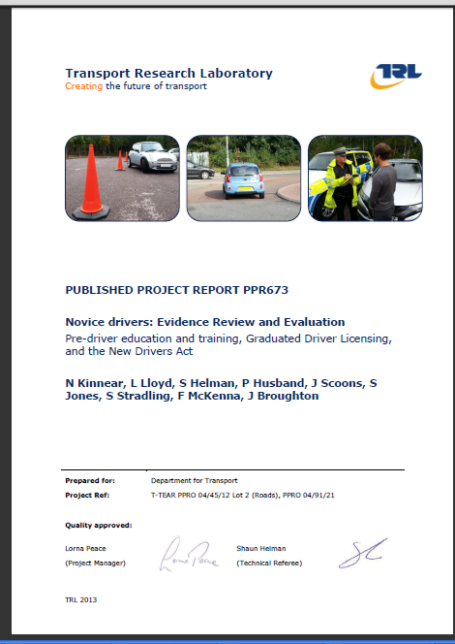
Kinnear et al (2013)
“The evidence that Graduated Licensing improves safety is compelling. Driver licensing in GB should be based on a strong Graduated System”

Slide 19
Does it work?
Crash type | Popn | Denominator | Time period | Effect (adjusted)
All crashes | All teenage drivers | Population | 1 year post implementation | 4 – 7% reduction
 |  | Licensed drivers |  | 11 – 19% reduction
Injury crashes | All teenage drivers | Population | 1 year post implementation | 4 – 23% reduction
 |  | Licensed drivers |  | 17% reduction
Hospitalisations | All teenage drivers | Population | 1 year post implementation | 19 – 20% reduction
Fatal crashes | All teenage drivers | Population | 1 year post implementation | 15 – 57% reduction
 |  | Licensed drivers | 1 year post implementation | 6 – 19% reduction
Night time crashes | All teenage drivers | Licensed drivers | 1 year post implementation | 3 – 48% reduction
Alcohol related crashes | All teenage drivers | Licensed drivers | 1 year post implementation | 19% reduction

Slide 20
What if we had implemented GDL (crash & lic)?

Slide 21
What if we had implemented GDL (cas & lic)?

Slide 22
Benefits of GDL (2)
Country | Proportion of all regional casualties that involved a young car driver (17–19 years old) | Expected reduction in all annual casualties from collisions involving a 17 to 19 year old car driver | Expected reduction in annual KSI casualties from collisions involving a 17 to 19 year old car driver | Expected value of benefits (£m)
Wales | 16.2% | 296 | 27 | 12.8
Scotland | 12.5% | 299 | 45 | 18.3
England | 11.6% | 3883 | 361 | 169.1
GB | 11.9% | 4478 | 433 | 200.1

Slide 23
Conclusions
YD crash problem is declining
  But inequalities YD to OD are still v large
  ?? Effect of austerity / recession
  Early 2014 data suggest rising numbers of crashes

Slide 24
Conclusions (2)
Young male crash rates have declined more steeply than young female
Universal, not targeted approaches needed
GDL is an obvious, universal approach

Slide 25
FAQs and other comments

Slide 26
Just because it works in other places...
There is no good reason why it would not work in the UK.
But, USA, Aus, NZ and Canada are all different – and GDL still works
Would the UK really be the first place where that trend would be countered?
Crashes occur in the UK in circumstances covered by GDL

Slide 27
The police are too busy to enforce GDL
Head of ACPO Roads Policing, Suzette Davenport, has expressed the need for GDL to be implemented.
CC Davenport has stated that the police will find ways to address enforcement and the driver identification issues that go with this.
But, parents are the primary enforcers, are strongly supportive of GDL and do not feel that the restrictions are inconvenient.

Slide 28
GDL would penalise the majority of law abiding teens
Most teens involved in fatal crashes do not have prior violations or crashes on their records
Many “model” teens are killed in car crashes.

Slide 29
GDL will hinder education or employment opportunities
NZ study
  8% of those subject to GDL said that the night time curfew hindered work
  1% said the passenger restriction hindered work
In the UK
  25% of 17-19 year olds hold a driving licence
  So 75% are able to manage work and education without a driving licence...

Slide 30
Restrictions are unfair
So are road traffic crashes, casualties and fatalities

Slide 31
Restrictions will not be complied with
“both parents and teens are generally much more accepting of the kinds of restrictions that have long been recommended for high-quality GDL systems than is generally assumed”
“by large majorities, the public wants enforced restrictions placed on young drivers before and initially after they receive their licences”
NZ study
  26% supported all three GDL conditions (night time, passengers and alcohol), but 78% would not breach the licensing conditions.
  30% believed the passenger restriction was convenient; it removed their responsibility for driving others.

Slide 32
More will drive without a licence
Frith and Perkins (1992) found that after introducing GDL the proportion of unlicensed drivers was almost unchanged
Here, cost of insurance a greater risk for driving illegally than implementing GDL.

Slide 33
Crash risk up when restrictions lifted
Not clear what will happen
Driving experience will be obtained

Slide 34
YD need a ‘trade off’ of lower learner age
Increasing the learner age from 16 to 16.5
  reduced the fatal crash rate in one study by 7%
  increase to 17 brought about a 13% decrease

Slide 35
Rural young people will be unfairly penalised
The burden of young driver crashes is greater in rural areas
  Road network
  long distances to medical care
Research comparing urban and rural attitudes to GDL
  Rural parents support GDL and at equivalent levels to urban areas

Slide 36
It will be unpopular with the voting public
RAC Foundation (2014)
  61% support for GDL
  41% of U24s support GDL, 32% oppose
  66% support passenger restrictions, 61% support night time driving restrictions
  41% of young people oppose passenger restriction, 40% oppose night time driving restriction
  34% of parents strongly support GDL

Slide 37
The policy context

Slide 38
So what?
What are we doing about this?
Current policy
  “Carrot not stick”
  Telematics
  Involve parents
  Look at education approaches

Slide 39
UK Government power
GDL legislation reserved to Westminster
January 2013 UK Gov announced forthcoming Green Paper on Young Drivers
  To be published by summer 2013
Asked TRL to produce evidence review
  Kinnear et al (2013)

Slide 40
UK Government power (2)
Green Paper repeatedly delayed
January 2014 – Green Paper postponed indefinitely
Jones et al (2014) BMJ called on UK Gov to take urgent action
Focus appears to be on telematics
  Unlikely to have same effect as GDL

Slide 41
Price of delay?
In 32 months Jan 2013 to end September 2015
 | GB | England | Scotland | Wales
Casualties associated with YD crashes | 11941 | 10355 | 797 | 789
KSI | 1155 | 963 | 120 | 72
Cost | £534M | £451M | £49M | £34M

Slide 42
Northern Ireland
Have power to make legislation on driving licences
Legislation before NI Executive
Consultation process closed 29/8/14
Signed Spring 2015

Slide 43
NI Proposals (2)
Repeal legislation around 45mph speed limit and R plate
Reduce L age to 16.5 with 1 yr min L period and logbook
Reduce BAC to 50mm for all drivers, 20mm for newly qualified drivers
Max 1 14-20 yr old passenger unless supervised, exemptions apply
Changes likely – passenger restriction during night time hours only

Slide 44
Isle of Man
October 2015
In response to a number of recent YD related deaths / injuries
Proposal
  R plate restrictions increased from 1 to 2 years
  R plate drivers allowed only 1 passenger
  R plate drivers have Midnight to 5am curfew
  No plan to increase L age from 16 to 17
  Previous proposal for lower BAC for L vetoed
  R plate already prevents >50mph

Slide 45

Public Health budget demands
Current threat to cut £200M from PH budget

Slide 46



Now
Learner period; un-restricted duration
Un-restricted full licence
1 in 5 newly qualified drivers crash within 6 months of obtaining their licence.
Most newly qualified drivers are aged under 25.
4 people per day are killed or seriously injured in crashes involving young drivers in the UK
Minimum length learner period
Fixed term, restricted intermediate period – no night time driving, no teen passengers, no alcohol
Graduated driver licensing could save 55 lives a year in Great Britain, prevent 5,000 casualties and save the GB economy £250M per year
With Graduated Driver Licensing

Slide 47


Now
DfT
plan
GDL
Time

Slide 48
Some other thoughts….
Tobacco was identified as a carcinogen in the 1950s
Smoking ban in 2007
New Zealand GDL in 1987
New York has had a night time driving curfew for over 40 years

Slide 49
Are you promoting what you believe to work or what you can prove, in terms of crash, casualty and fatality reductions, works?

Slide 50
And finally...
Most / all of commonly asked questions / concerns can be countered with evidence
Road safety, police engaged with advocacy
Where is health?
Can and should health advocate for another govt dept to take action?

Slide 51
“Change is the law of life. And those who look only to the past or present are certain to miss the future”
John F Kennedy
“All the forces in the world are not so powerful as an idea whose time has come”
Victor Hugo
Notes:
In public health we often have the difficult choice of leading change or the easy choice of waiting for some one else to do it, if they get around to it. GDL falls in to one of those areas in which PH has a wealth of experience – pulling together disparate groups with a common purpose. This is an area of change that PH is perfectly placed to advocate for.

Slide 52
Acknowledgements
Stephen Palmer
Dot Begg, IPRU, University of Otago, NZ
David Stone
Brendan Mason
Jo Sibert, John Spence, Mansel Aylward and Board of Public Health Wales
Alison Hill, Sir Muir Gray
Karen McFarlane (CiW)
Shaun Helman, Neale Kinnear (TRL)
Scott Pendry (ABI)
Roger Williams, MP, David Stewart, MSP
PACTS, Road Safety Scotland, Road Safety GB, Brake
Suzette Davenport, ACPO Roads Policing lead; Dave Jones
Notes:
SRP like marmite
Closer to home… John Spence and Jo Sibert

