Slide 1
LOcHER – Health & Safety Projects
01/02/2022

Slide 2
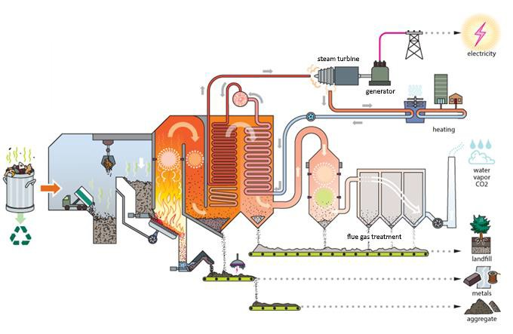
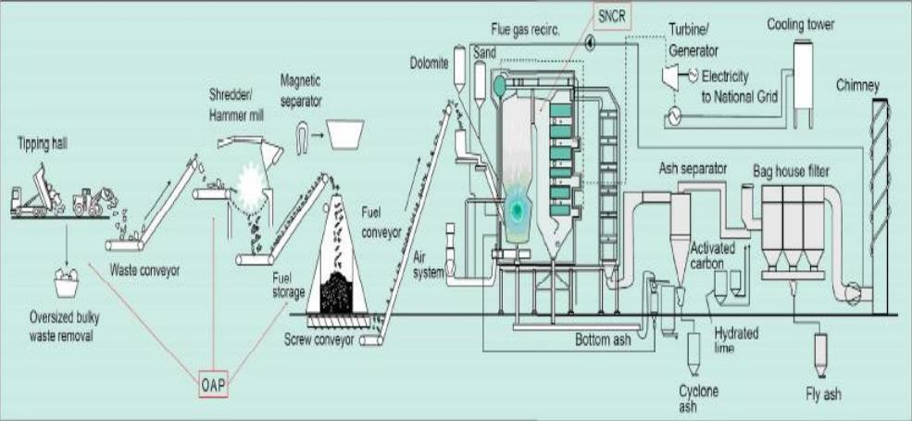
Energy from Waste Schematic - Process Overview

Slide 3

LOcHER Project Stats to Date
10 work placements, interns and apprentices involved with MVV and LOcHER to date
25 year contract with D&A to accept work placements, apprentices, internships providing an ideal base for future projects and engagement through a community benefits
Now in collaboration with Developing the Young Workforce Dundee and Angus (DYWD&A)
Members of the management team are enrolling as STEM ambassadors
Over 500 hours spent on Projects
2/2/2021

Slide 4
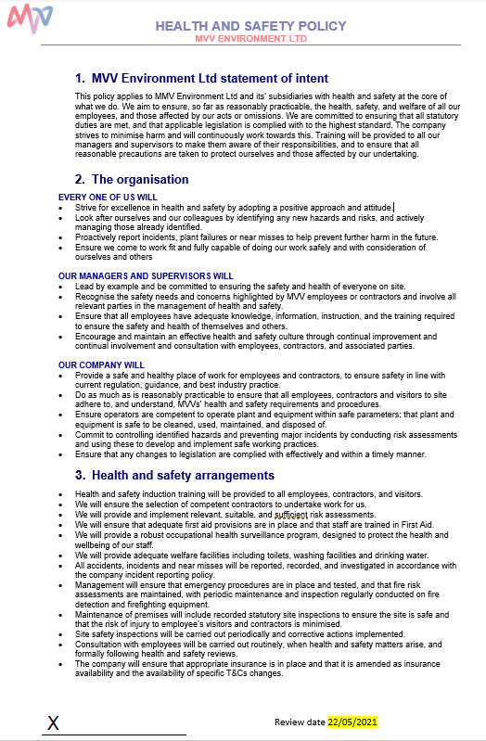
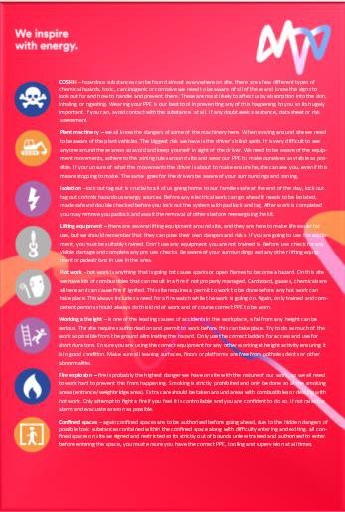
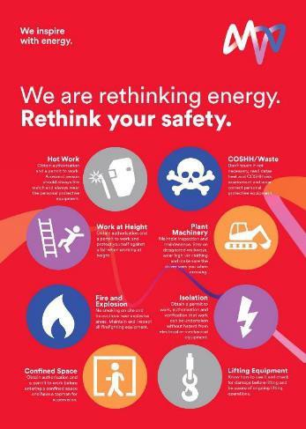

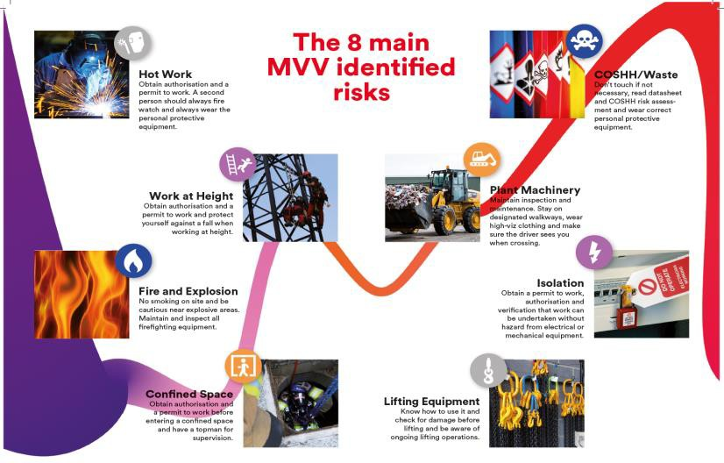
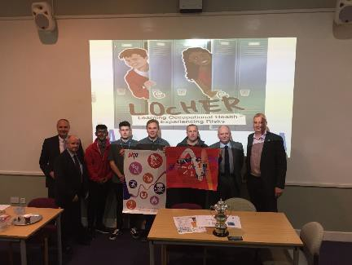
Past Projects
H&S Policy Draft
Tool Box Talks and Safety Cards
Creation of Safety Posters and Leaflets
2/2/2021

Slide 5
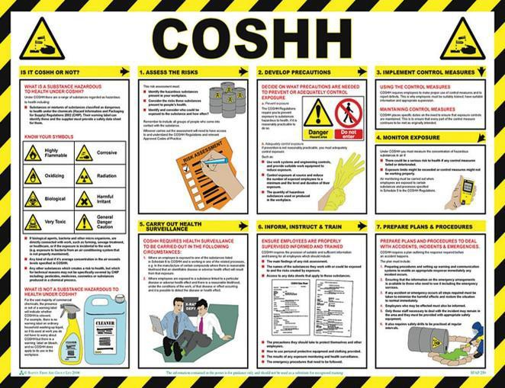
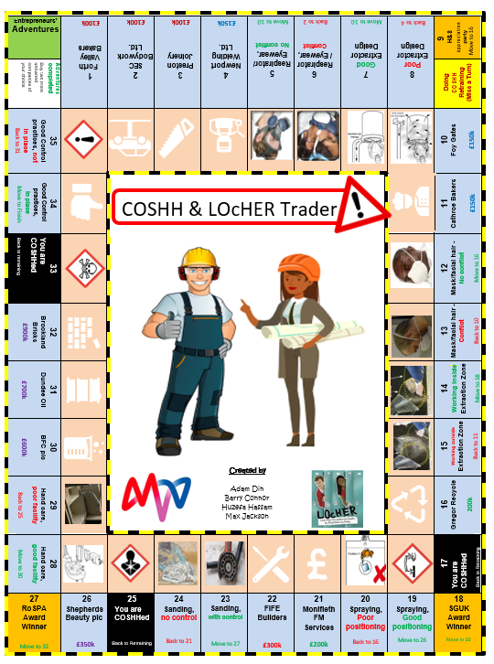
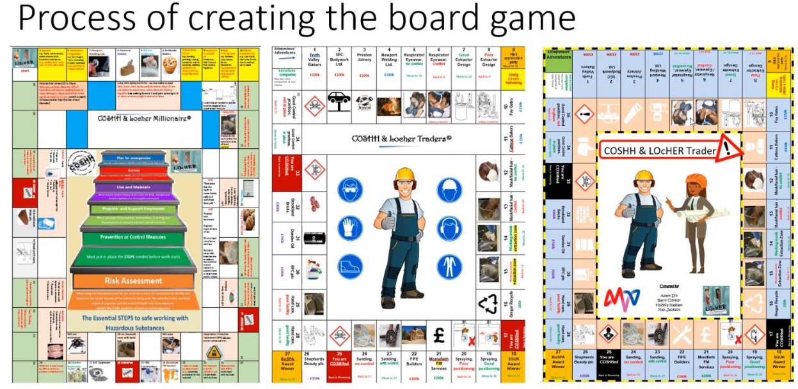
Project in Collaboration With the HSE
2/2/2021

Slide 6
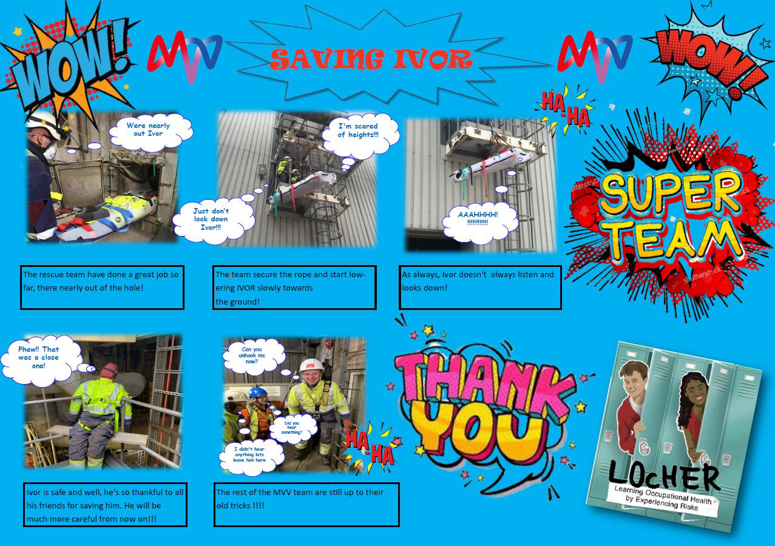


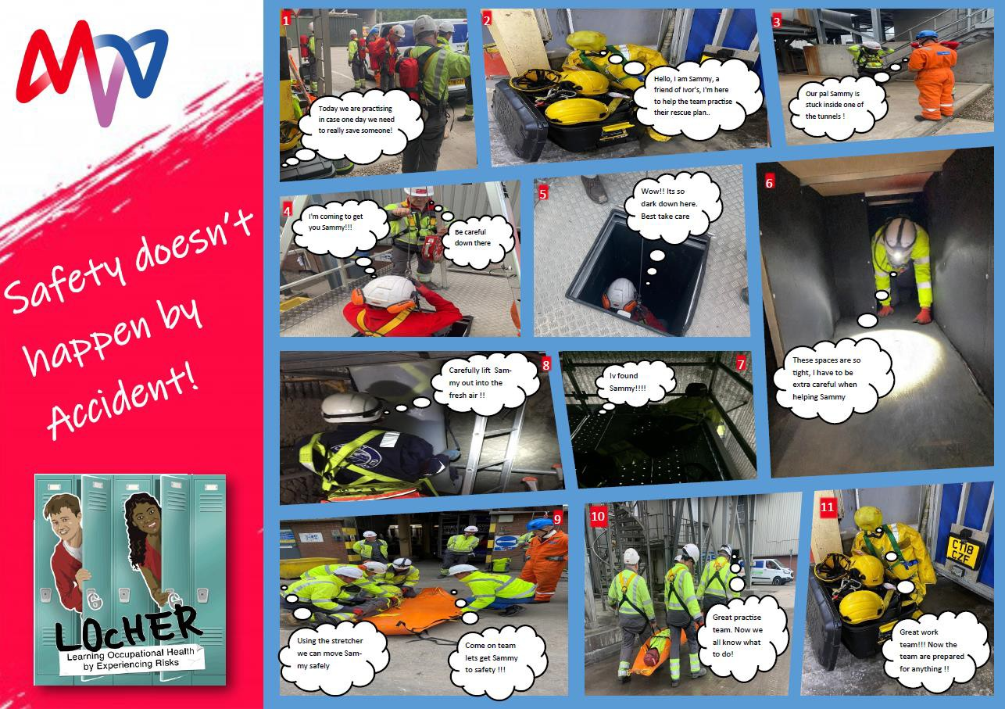

Current Project Target Every Primary School D&A
2/2/2021

Slide 7
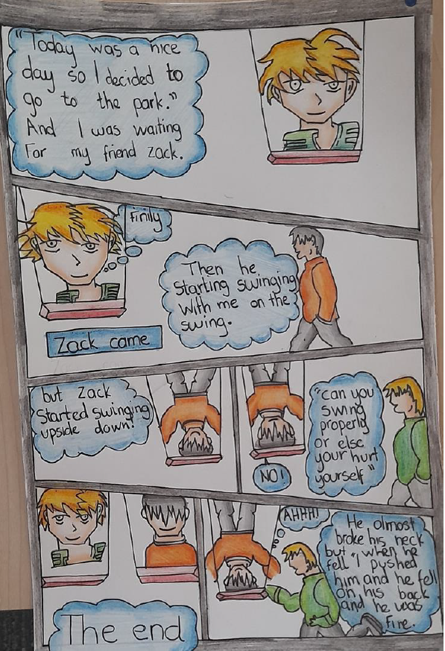
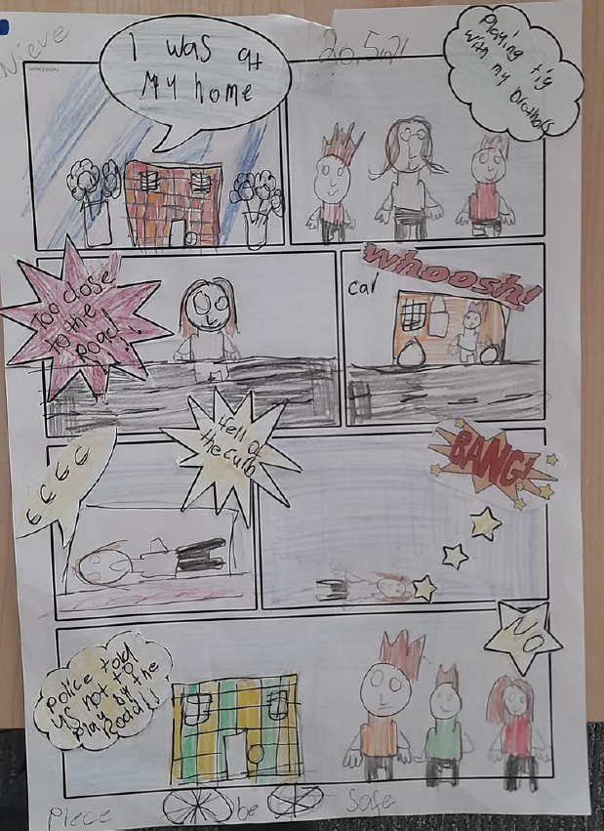
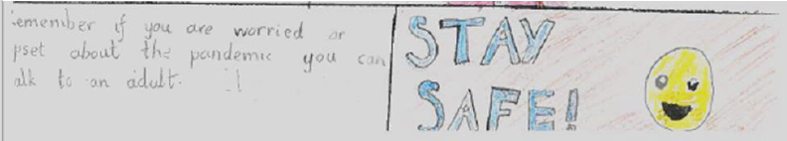
Winners of Angus Council Schools
2/2/2021

Slide 8


Gregor McGhee QHSE Manager
MVV Environment Baldovie Limited
Forties Road
Dundee DD4 0NS
www.mvvuk.co.uk

