Slide 1
The Work of Trading Standards in Scotland
David MacKenzie
Chair, Society of Chief Officers of Trading Standards in Scotland (SCOTSS)

Slide 2
Trading Standards Activities
  Investigations from complaints and other intelligence
  Inspecting, sampling, testing, auditing
  Advice and guidance to businesses
  Prevention is better than cure
  “Equidistance” between business and consumers – i.e. don’t “take sides”
  Formal action reserved for most serious cases

Slide 3
Topics
  Age Restricted Sales
  Animal Feedstuffs
  Animal Health & Welfare
  Anti-counterfeiting
  Business Protection Regs
  Consumer Buying Rights
  COVID premises restrictions
  Descriptions, Omissions, Aggressive
  Doorstep crime
  e-Crime and e-Commerce
  Electro-magnetic Compatibility
  Home Reports
  Illegal moneylending
  Price Marking and Comparisons
  Product Safety
  Scams
  Storage of Petrol & Explosives
  Tobacco and NVP controls
  Unfair Terms
  Weights and Measures

Slide 4
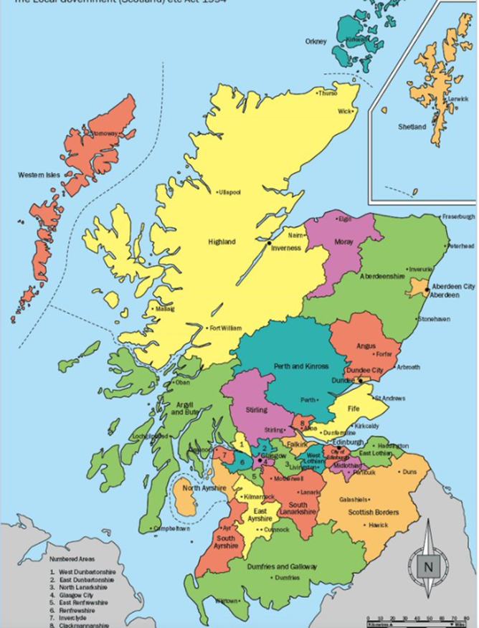
Trading Standards in Scotland
  31 local authority Trading Standards services
  Trading Standards Scotland
  Scottish Branch of CTSI
  Society of Chief Officers of Trading Standards
  in Scotland (SCOTSS)
  One “Trading Standards” brand?

Slide 5

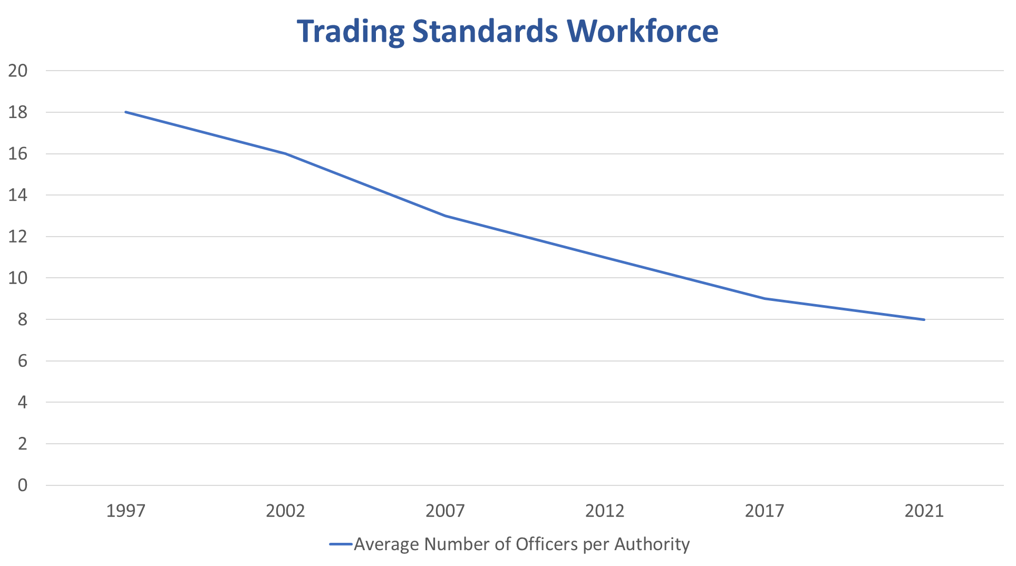

Slide 6
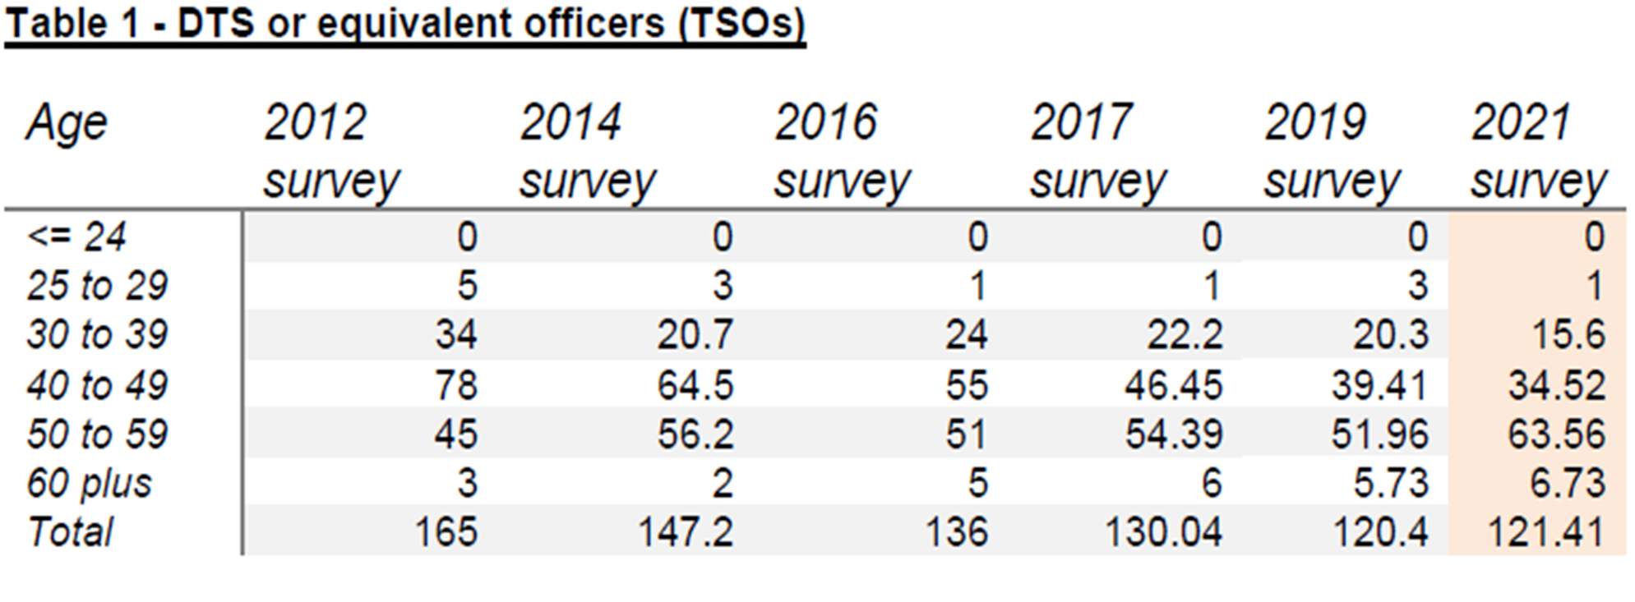

Slide 7

Priorities
  Priorities arising out of Government Policy
  National
  Local
  Examples

Slide 8
Priorities from Govt Policy
  Fireworks: successful partnership and cooperation
  Illicit Tobacco – Operation CeCe
  Tobacco and age restricted products
  Single use plastics and deposit return schemes
  State Veterinary Service project
  Imperial measures?

Slide 9
National Priorities
  Cost of Living crisis: energy measurement and prices
  Net Zero: green claims, other environmental issues
  Single use vapes and sales to young children
  Tackling online crime and compliance issues
  Scams
  COVID compliance and recovery
  Brexit

Slide 10
Local Priorities
  Falkirk: Grangemouth and imports
  Edinburgh and Renfrewshire: issues linked to airports
  West Central Scotland: serious organised crime
  Highland: internet delivery surcharges
  Orkney, Shetland and Comhairle nan Eilean Siar: islands issues

Slide 11
Main Safety Topics
  Product Safety
  Safe Storage of Explosives
  Sales of Fireworks
  Safe operation of Petrol Filling Stations

Slide 12
Final Thoughts
  Partnership sounds like a tired cliche but is the only way ahead for most public bodies
  So it’s crucial that we all try to “put ourselves in the shoes” of colleagues from other agencies when liaising
  Informed, targeted, planned, pragmatic, collaborative work on consumer issues can achieve a lot
  Keeping our communities safe is always Number 1 Priority

Slide 13
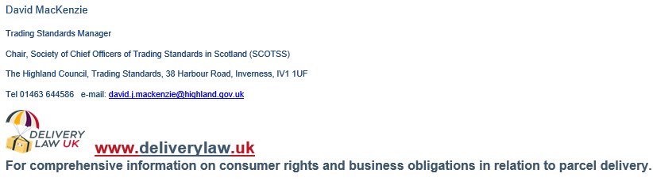

Slide 14
The Work of Trading Standards in Scotland
David MacKenzie
Chair, Society of Chief Officers of Trading Standards in Scotland (SCOTSS)

