Slide 2
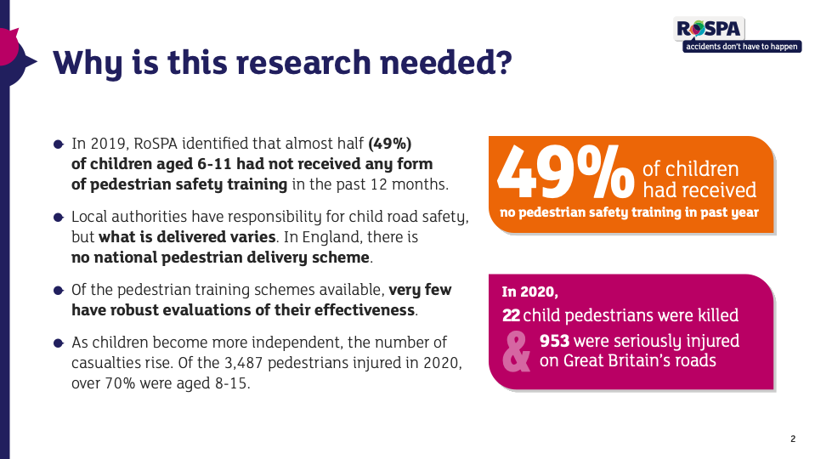

Slide 3
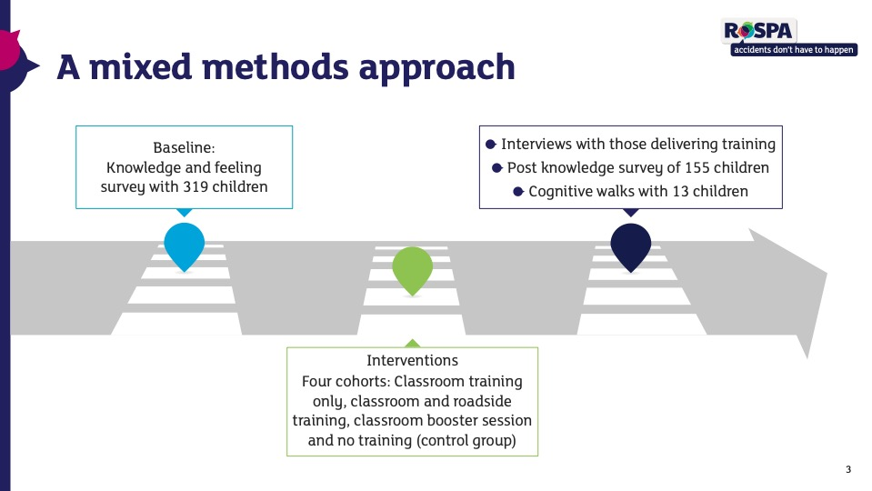

Slide 6
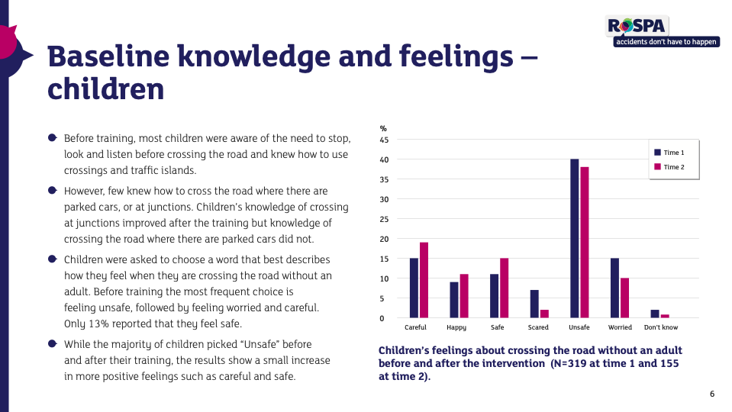

Slide 7
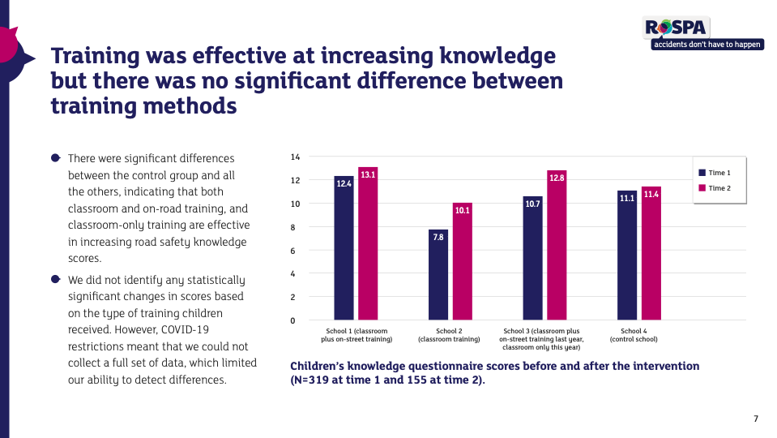

Slide 12
Contacts
Becky Needham
Road safety officer, England, RoSPA
Email: rneedham@rospa.com

